Slide 1



MRA Messages™

Slide 2



2 Q’s for Relevancy

Slide 3




ODC in Communication™

Slide 4


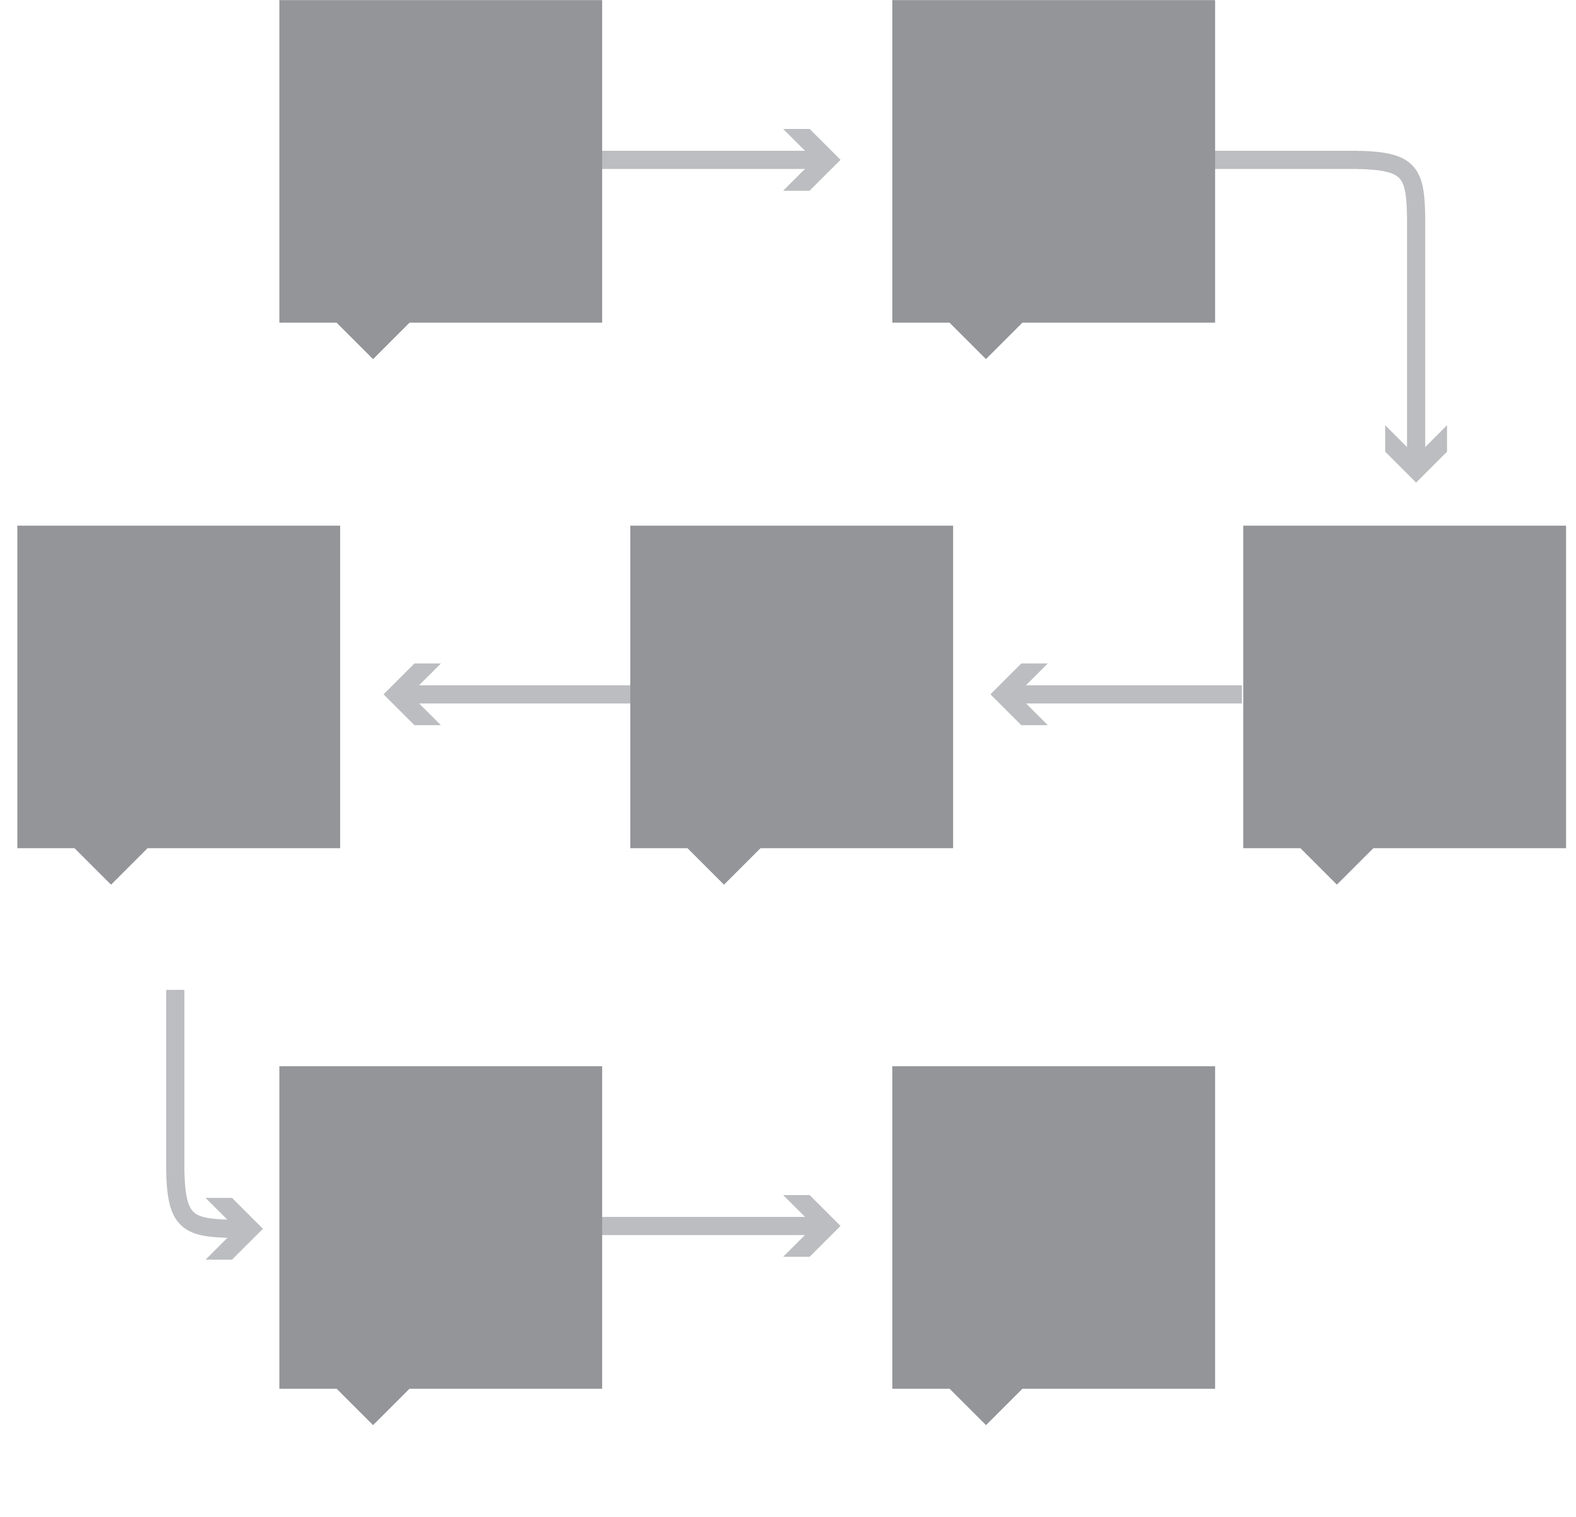




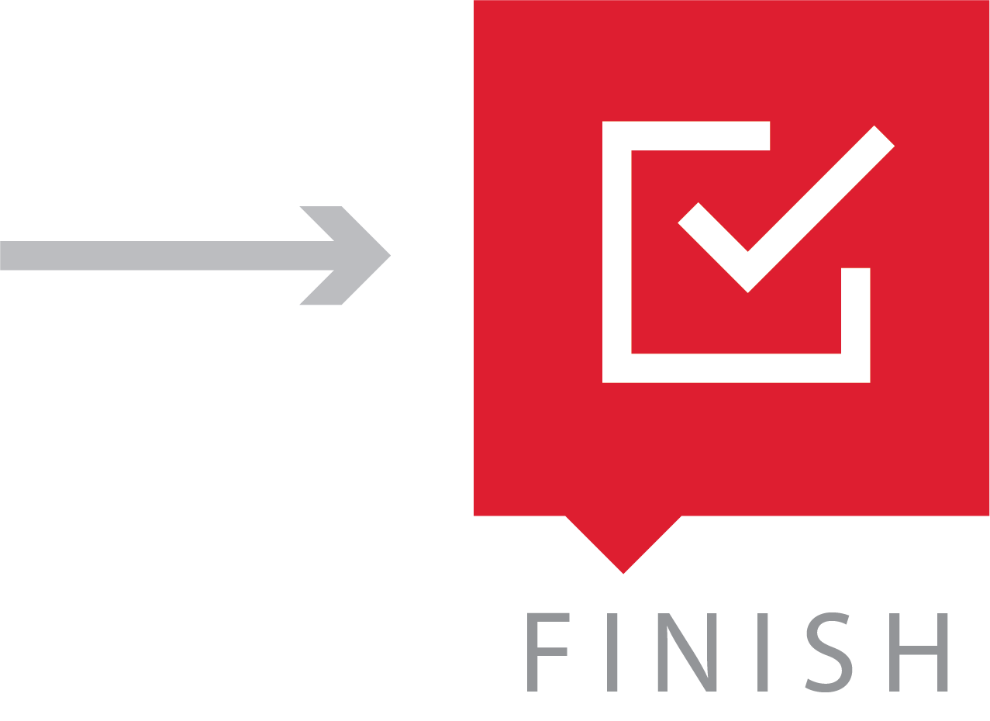
Survey Implementation Plan™

Slide 5





Four P’s of Meetings™

Slide 6




MVP™

Slide 7
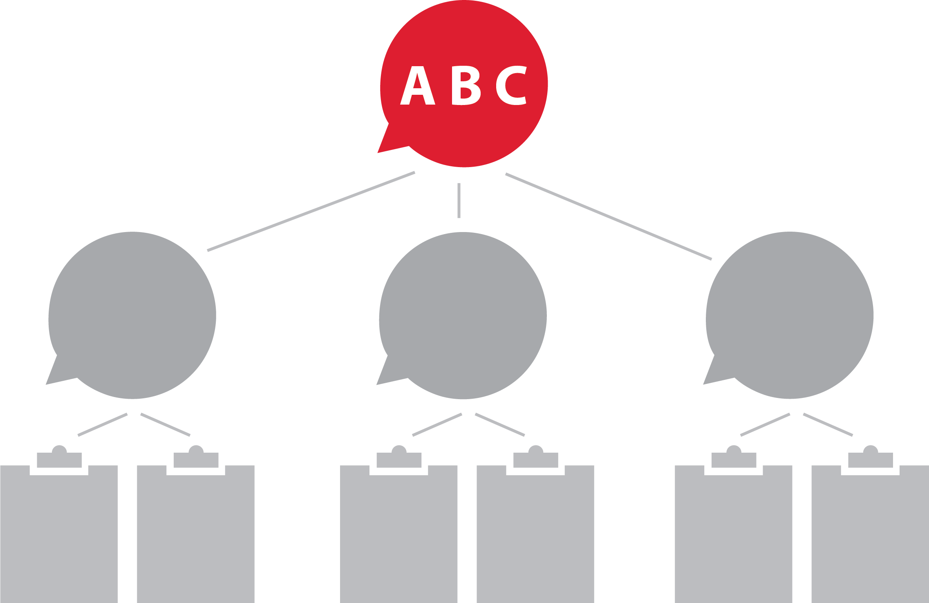
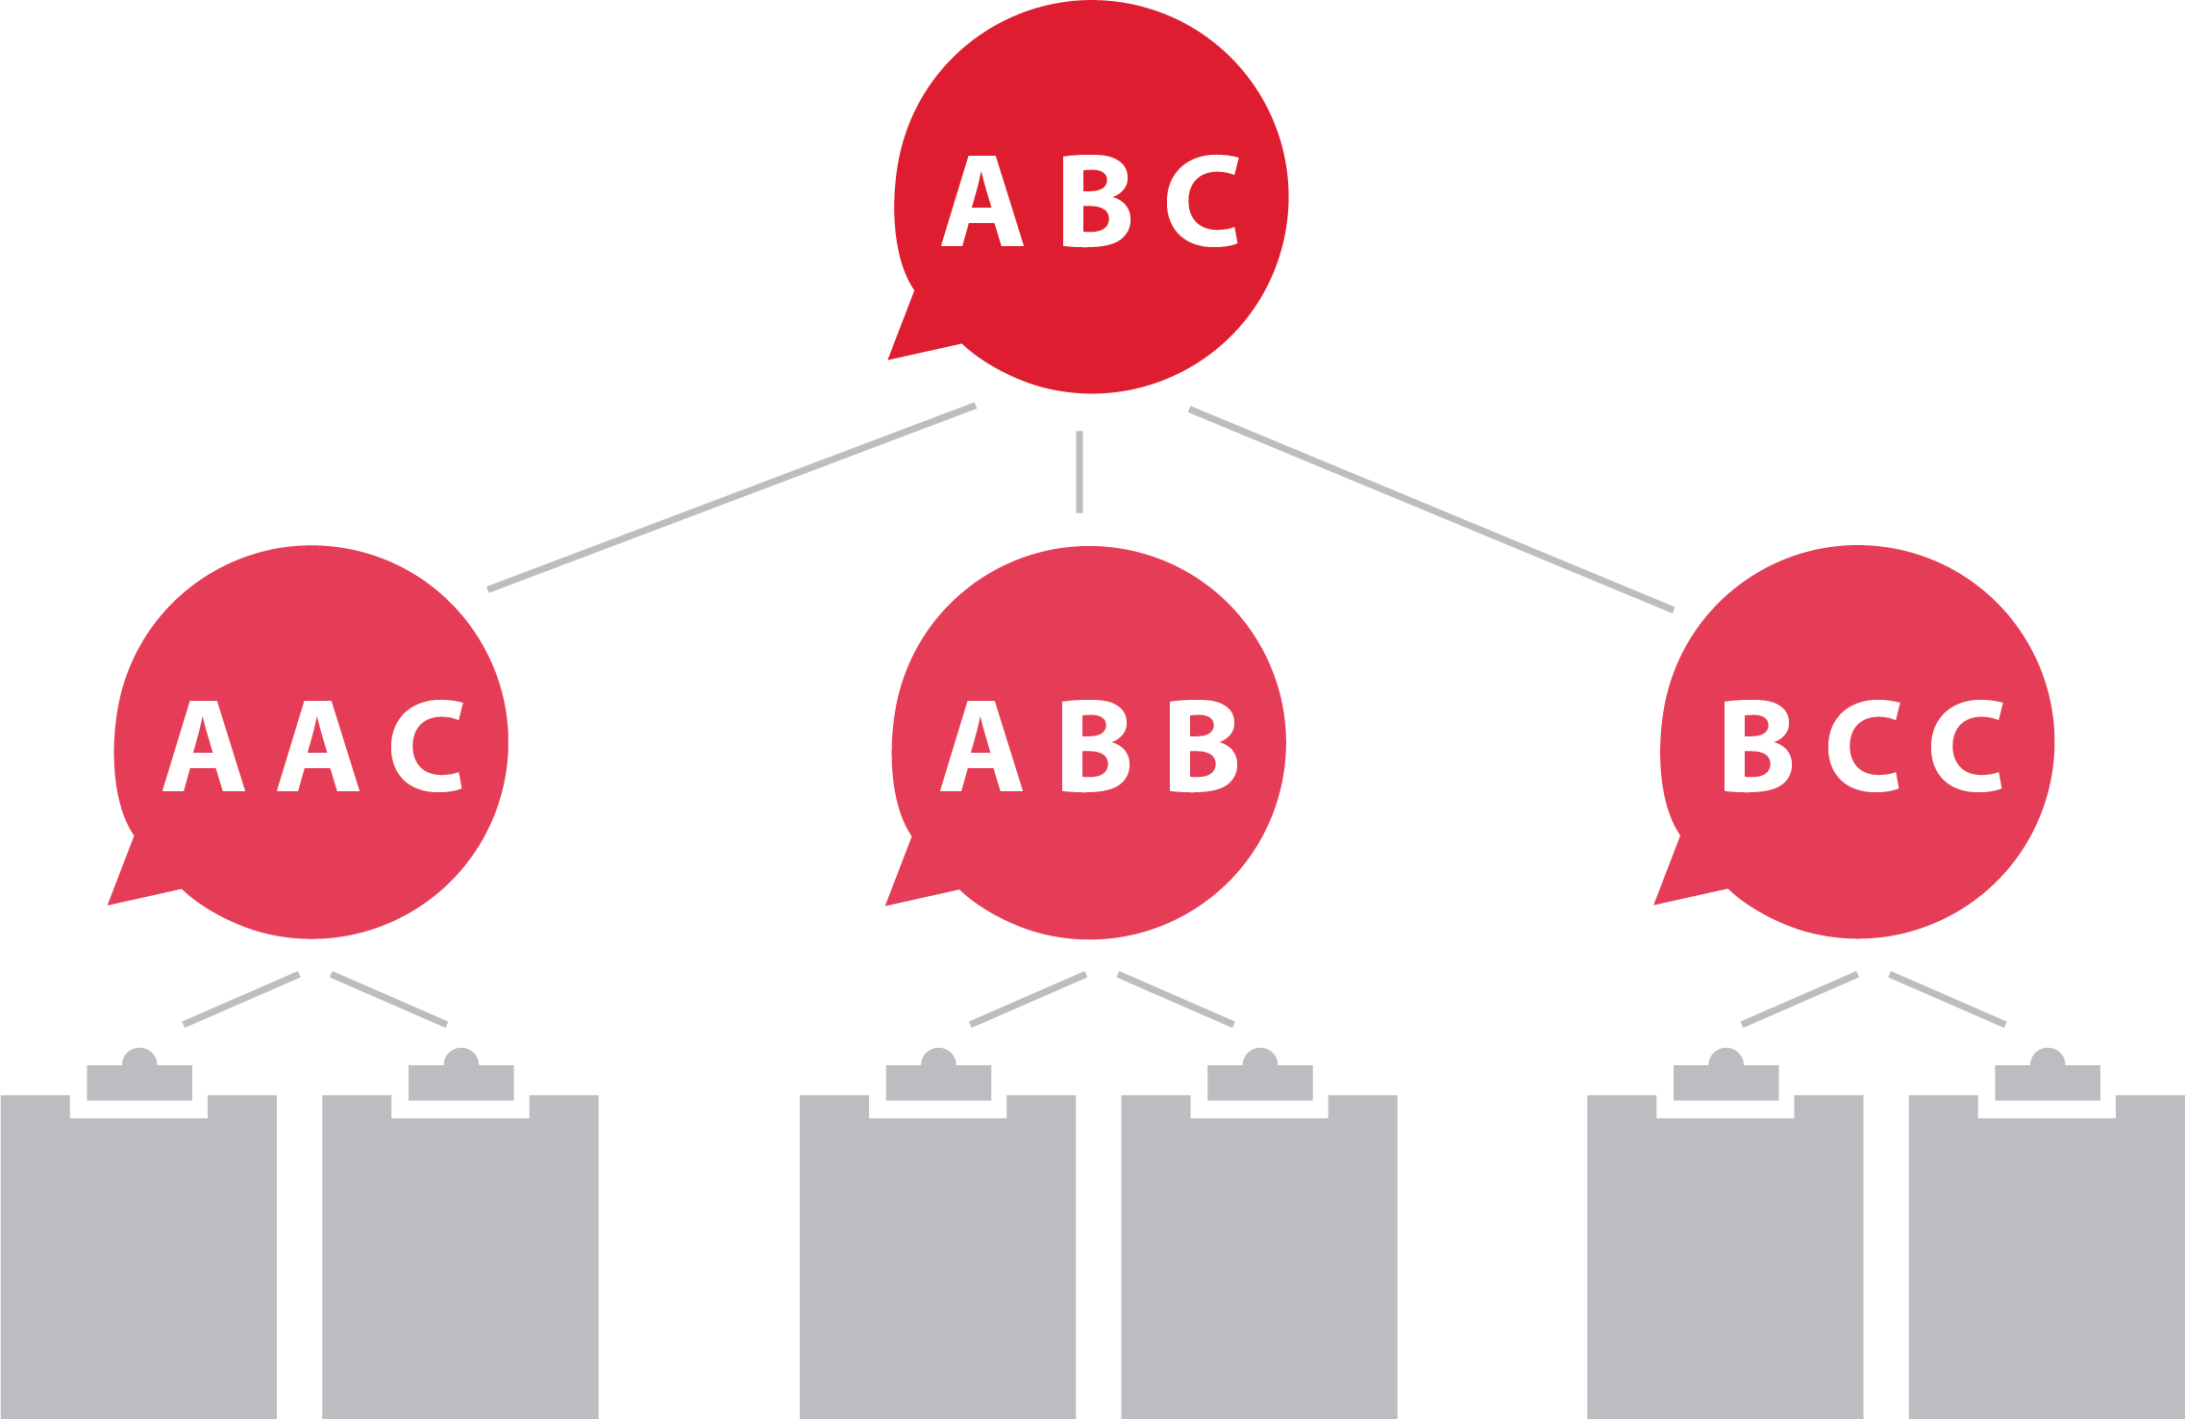
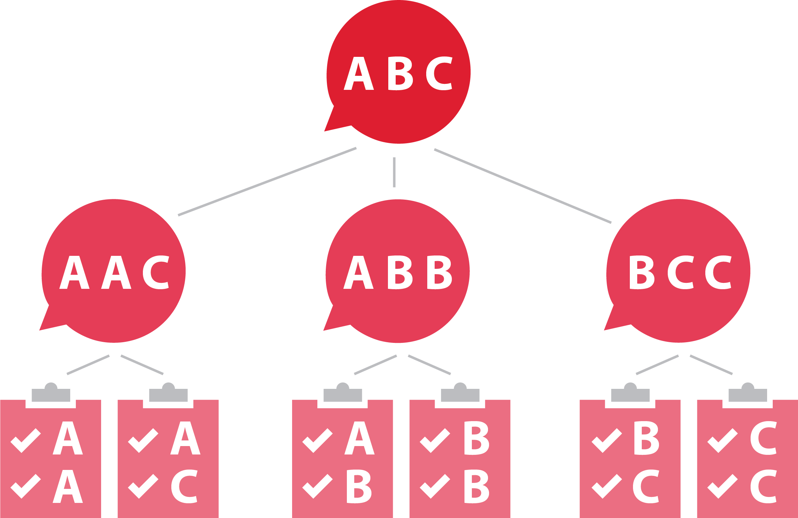
Priority Alignment™

Slide 8




How? How? How?™

Slide 9
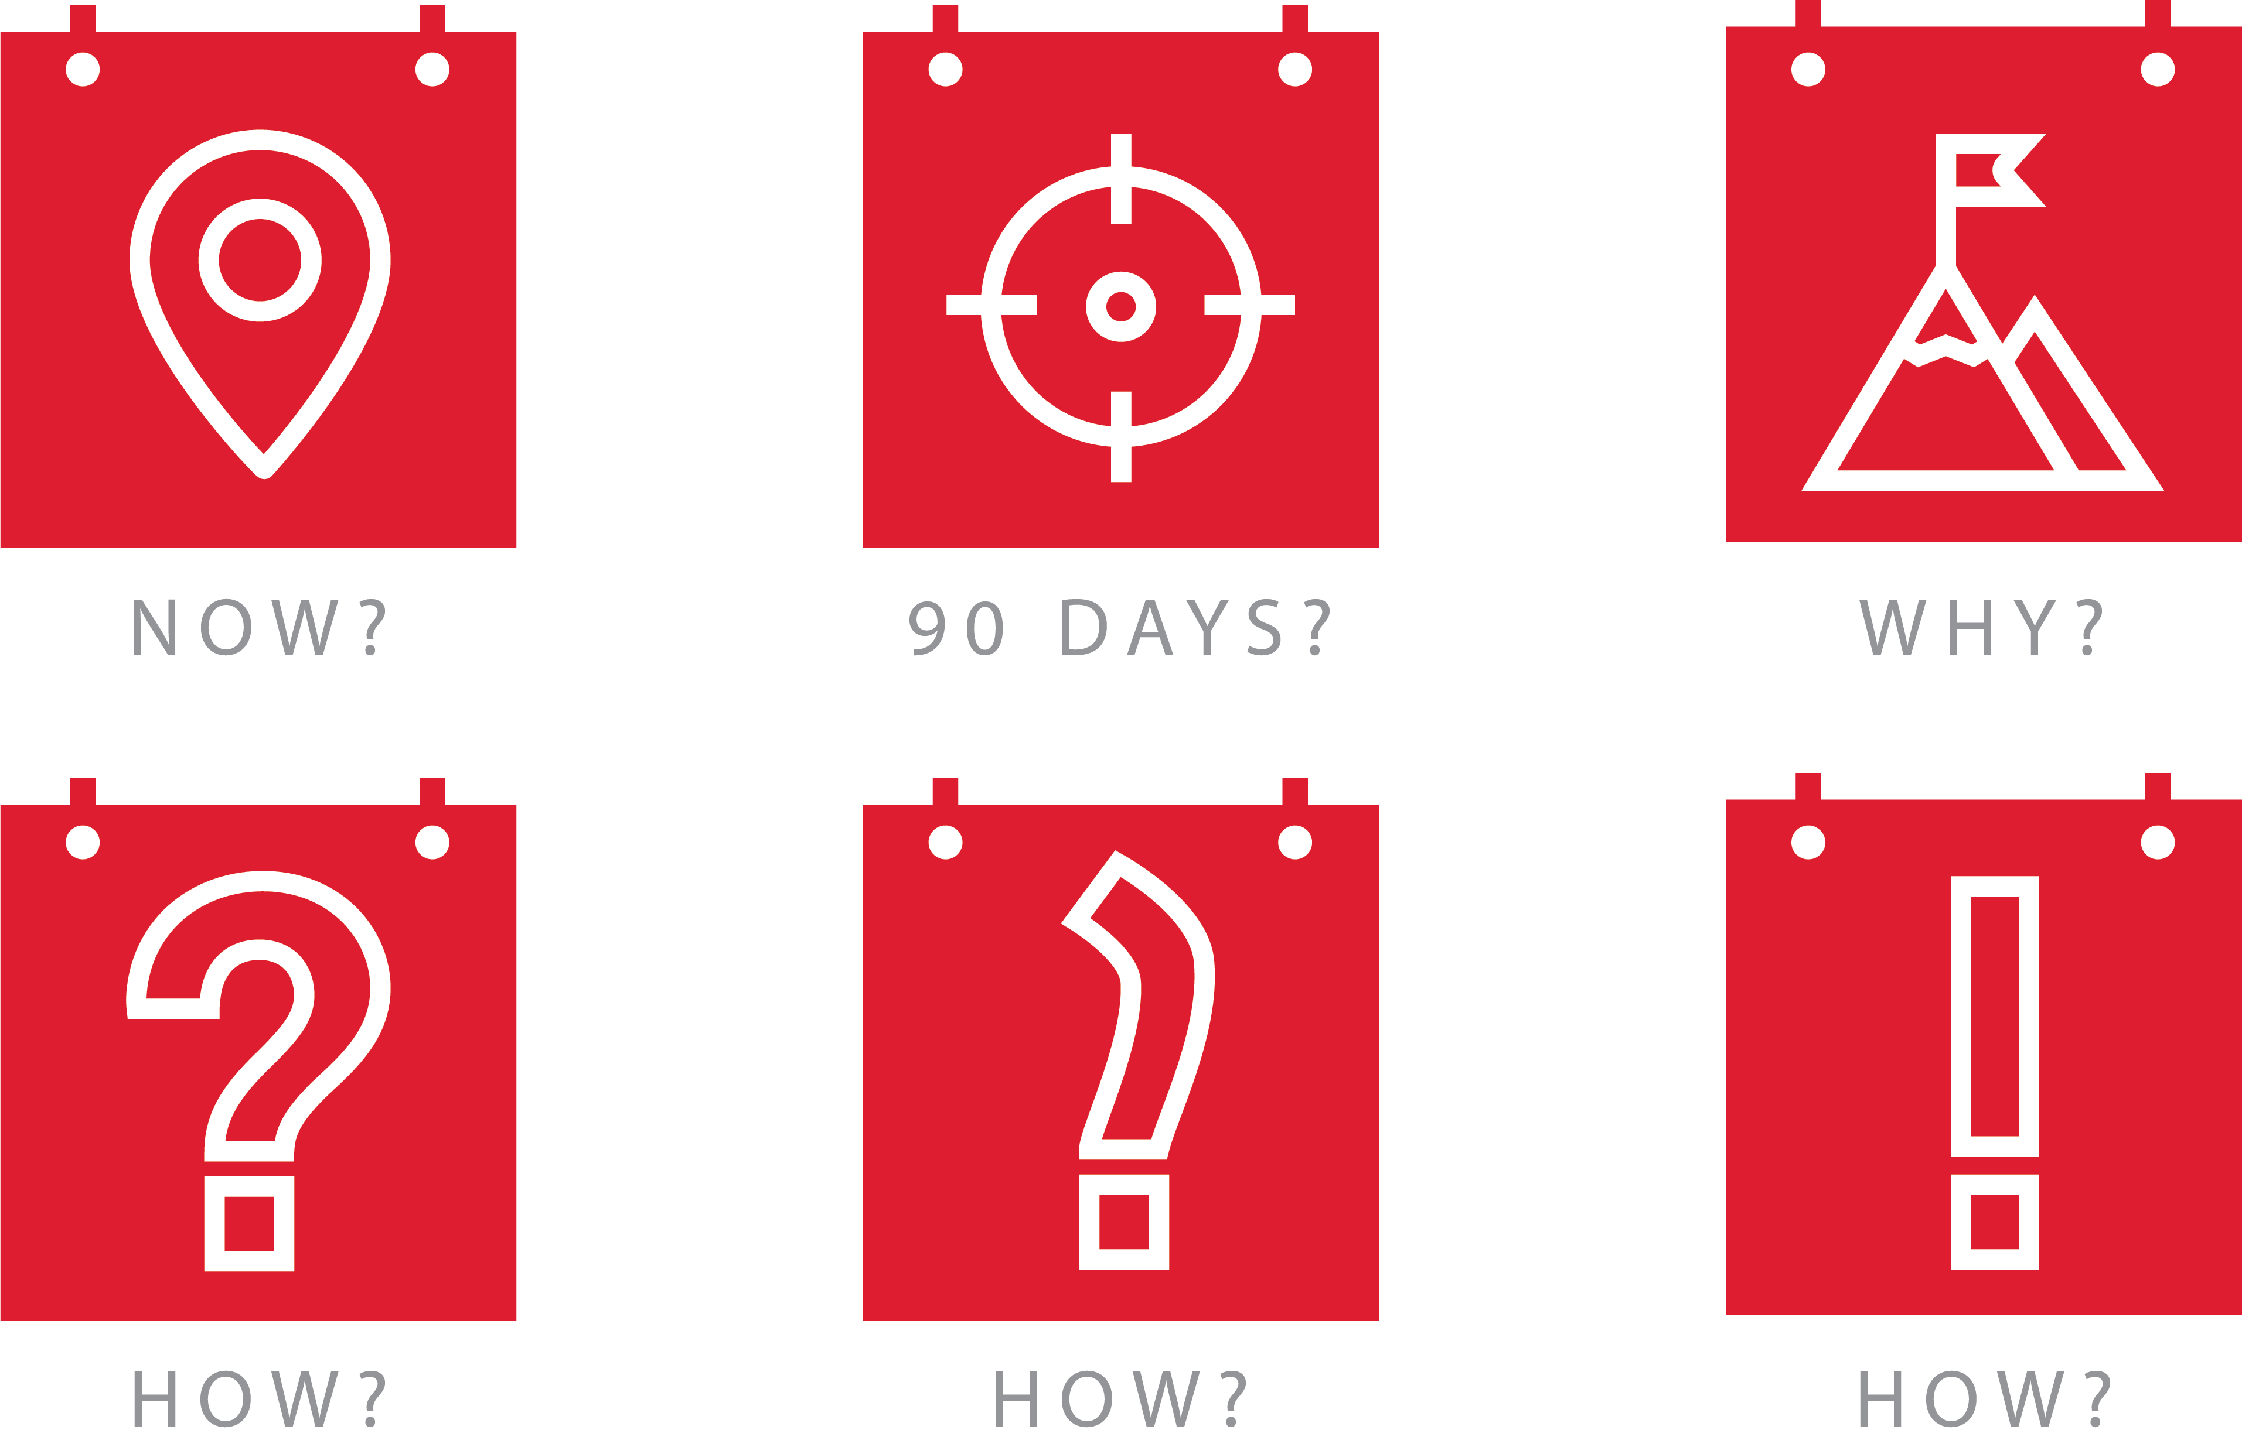


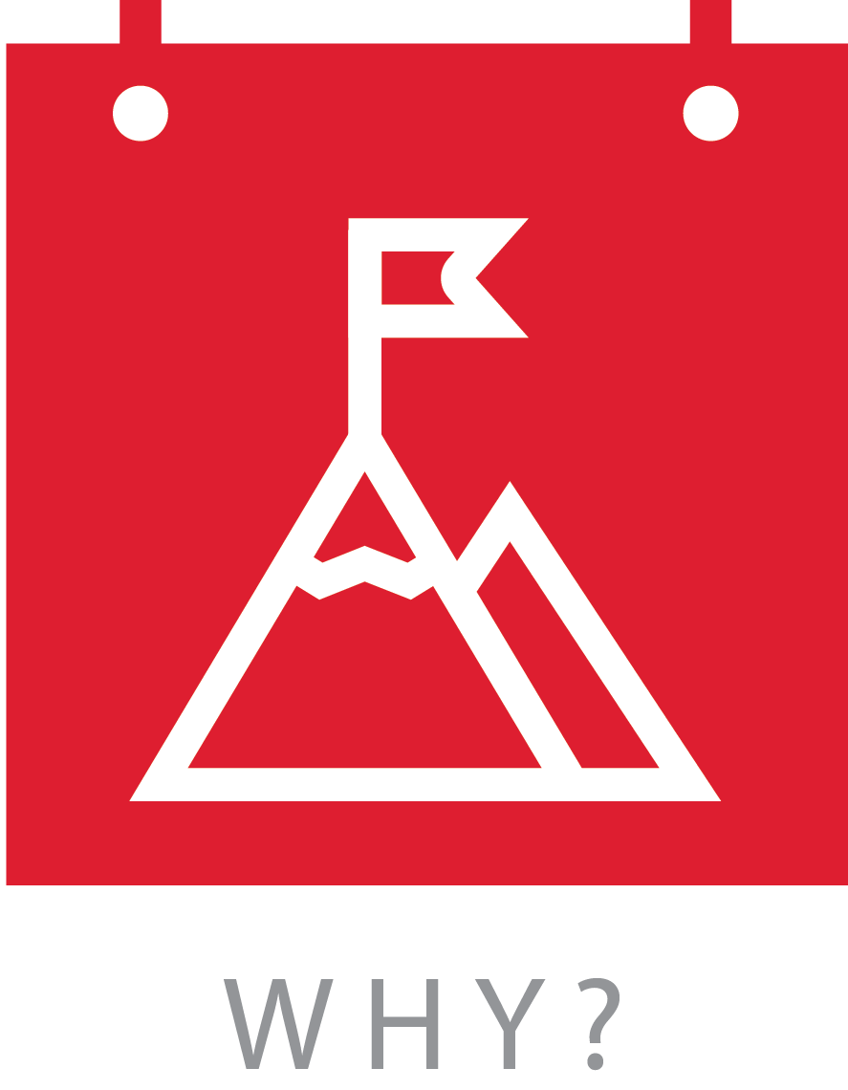
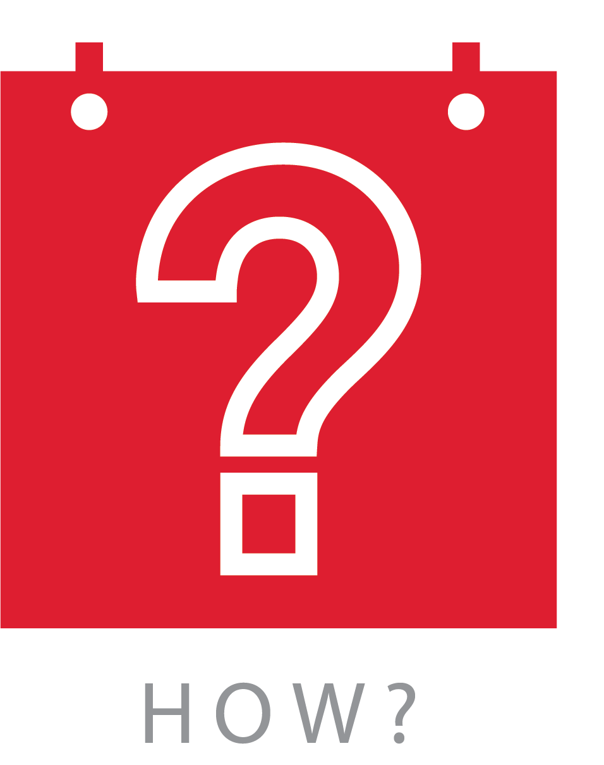
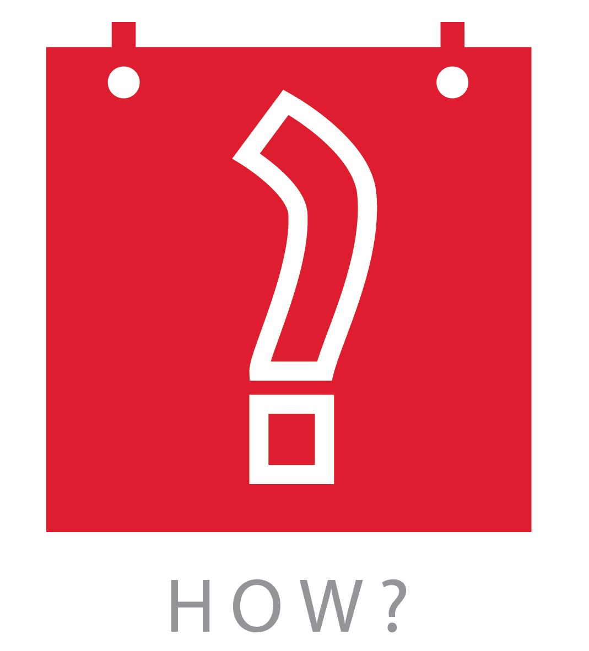
90-Day Quick Plan™

Slide 10





LAWS of Compassion™

Slide 11


SPA Appreciation™

Slide 12





PAWS in Conflict™

Slide 13


Decision-Making Values™

Slide 14

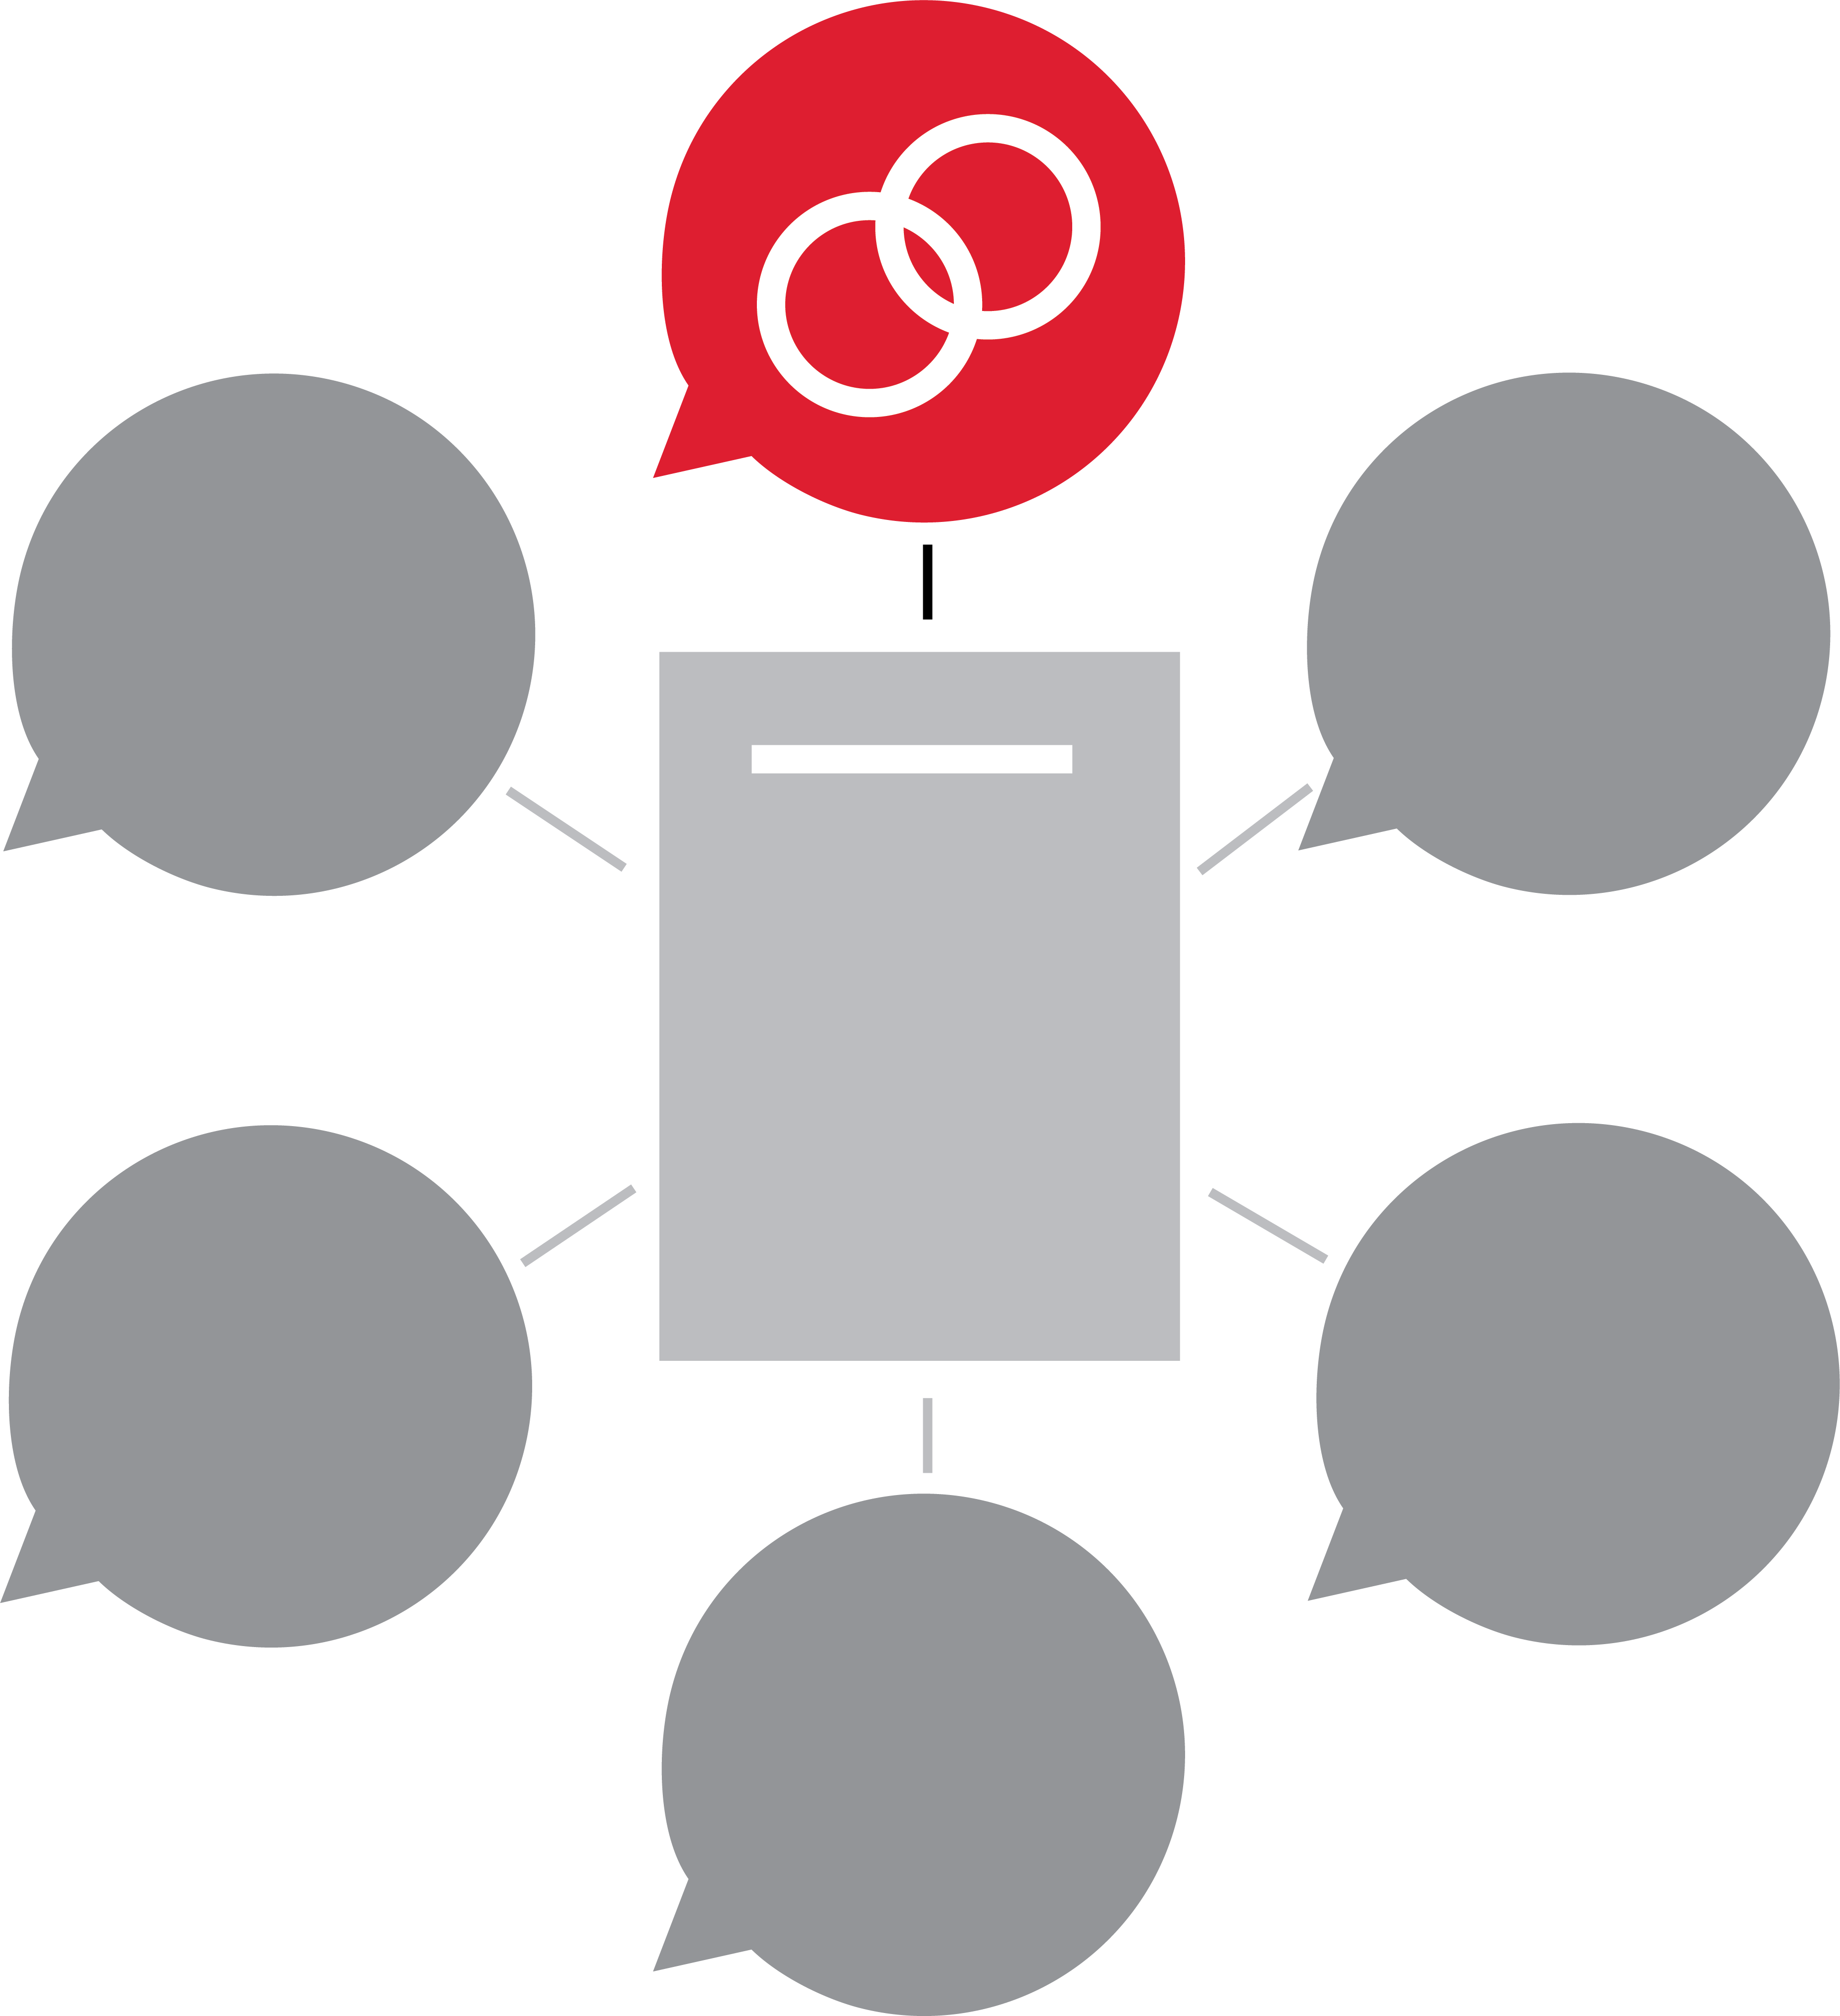
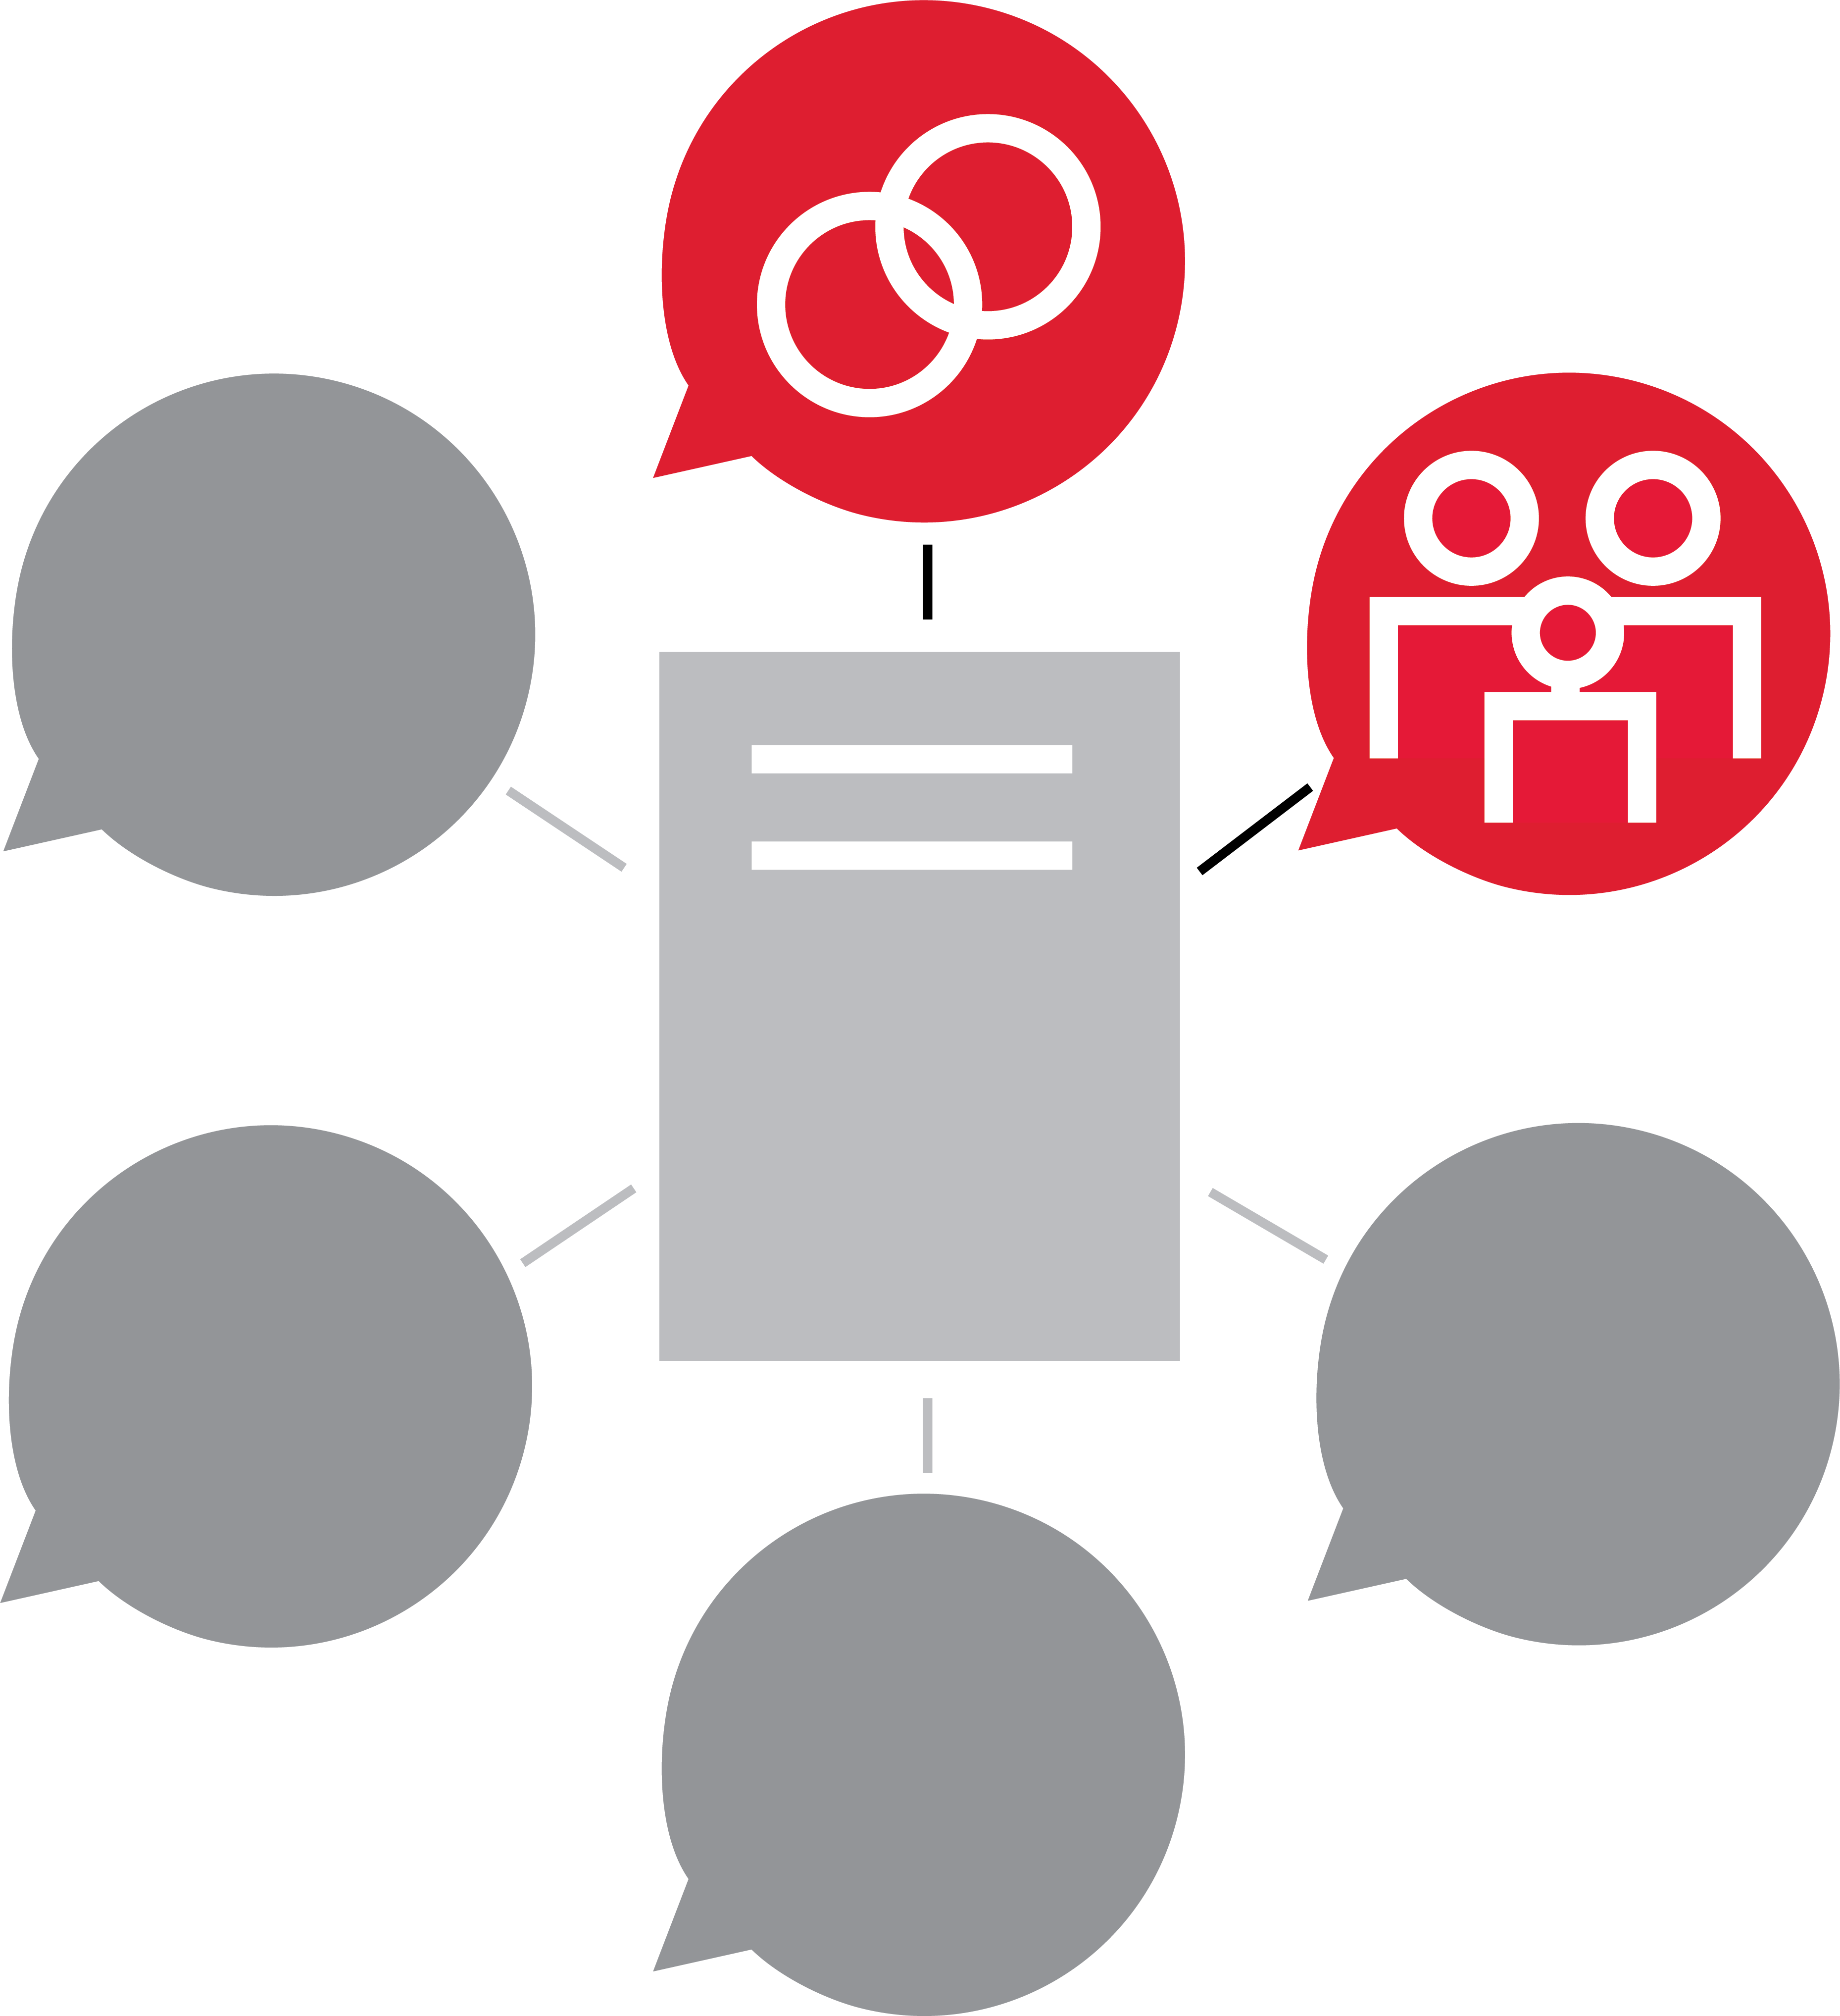
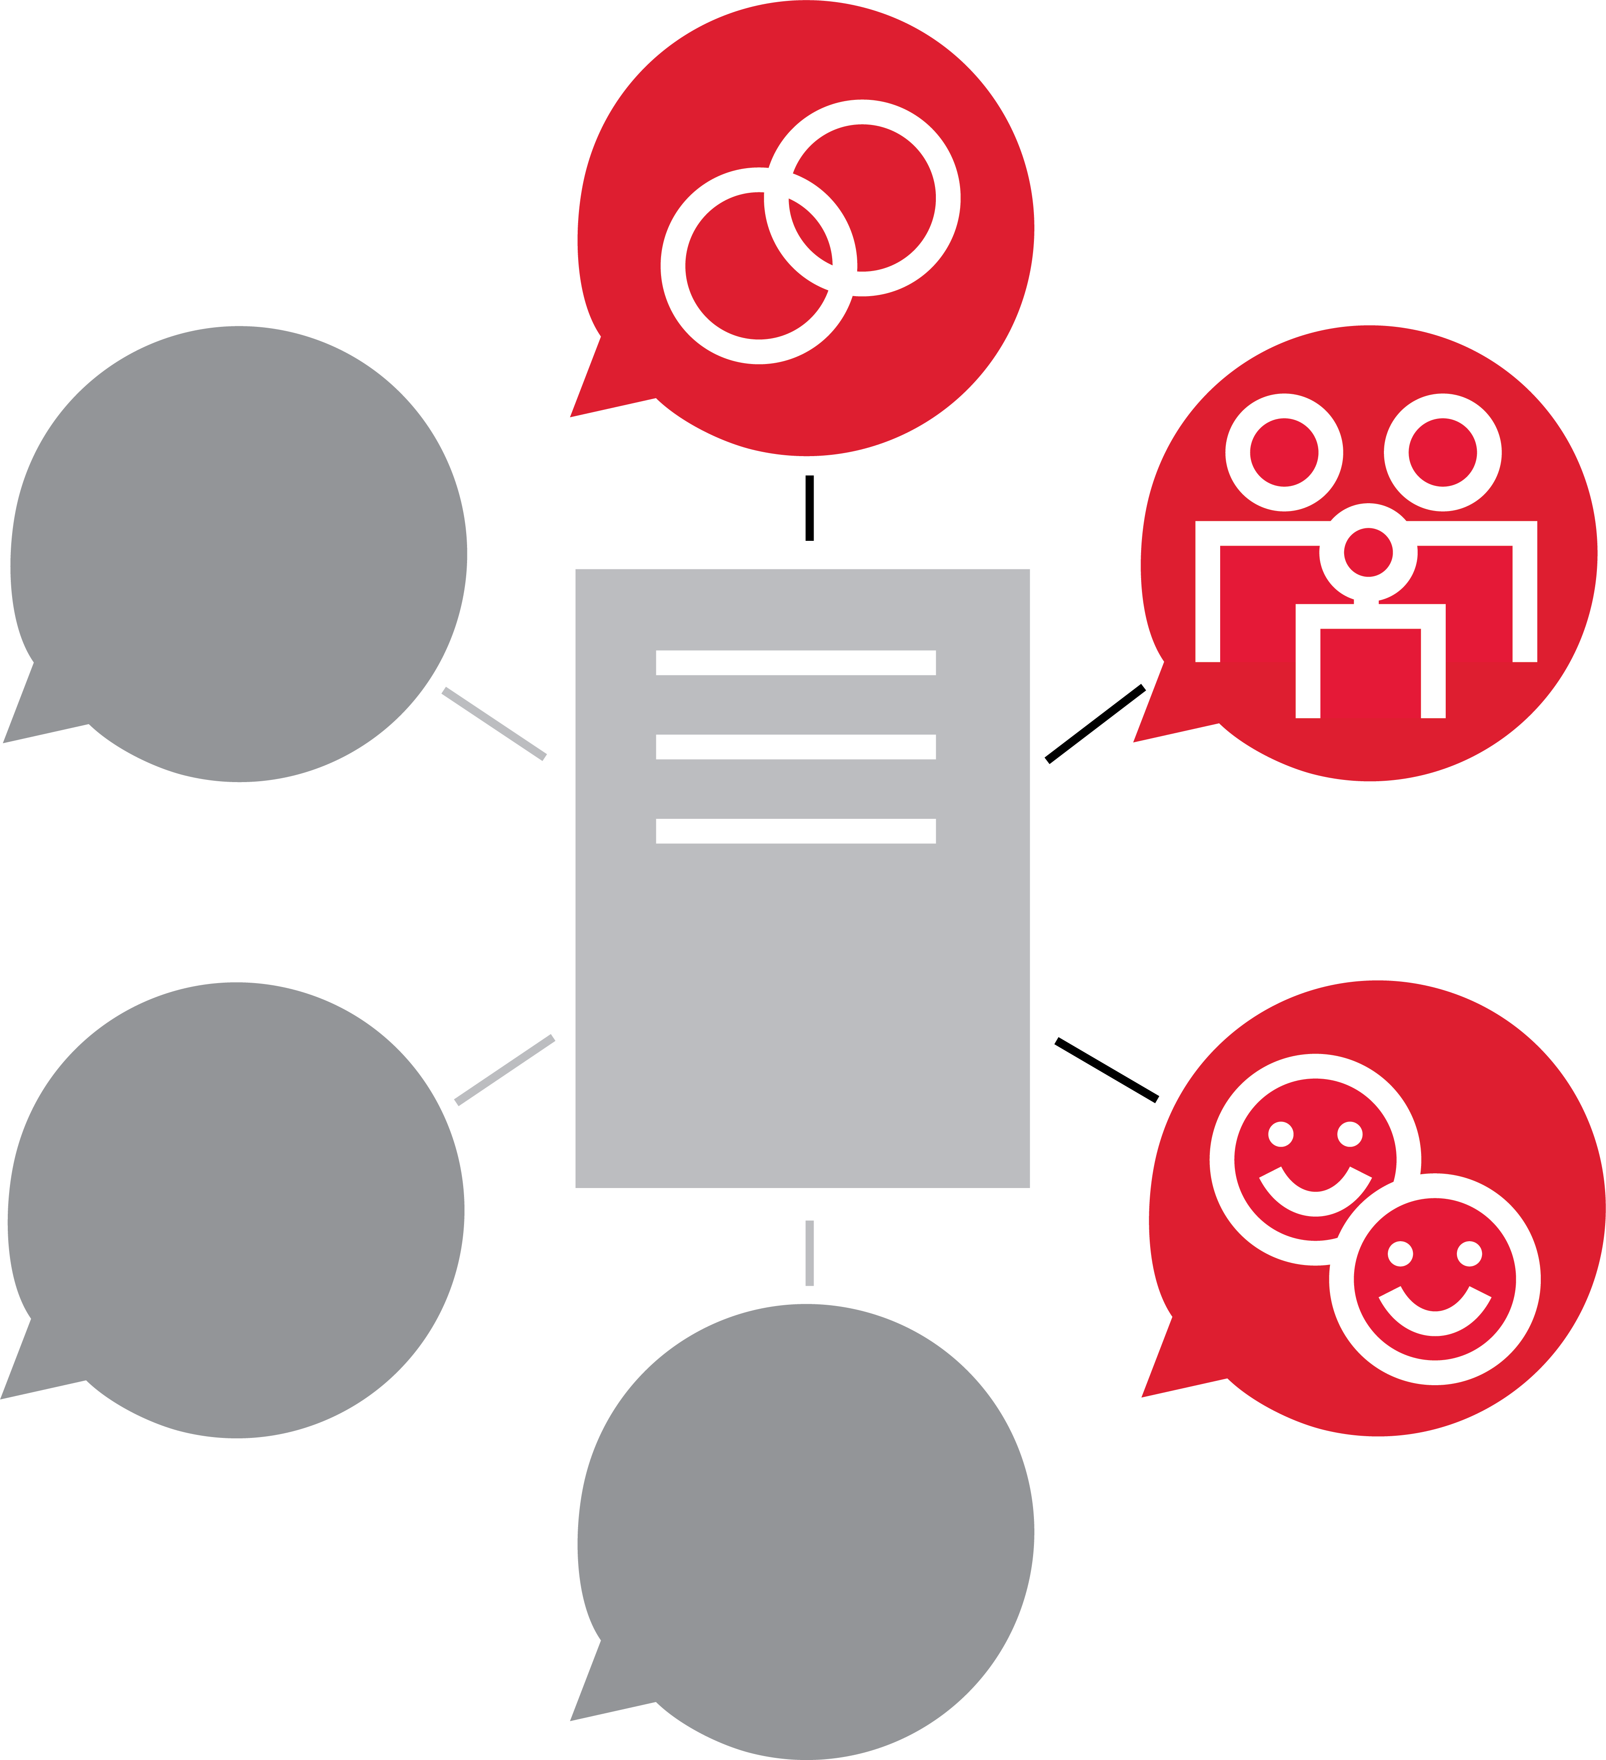
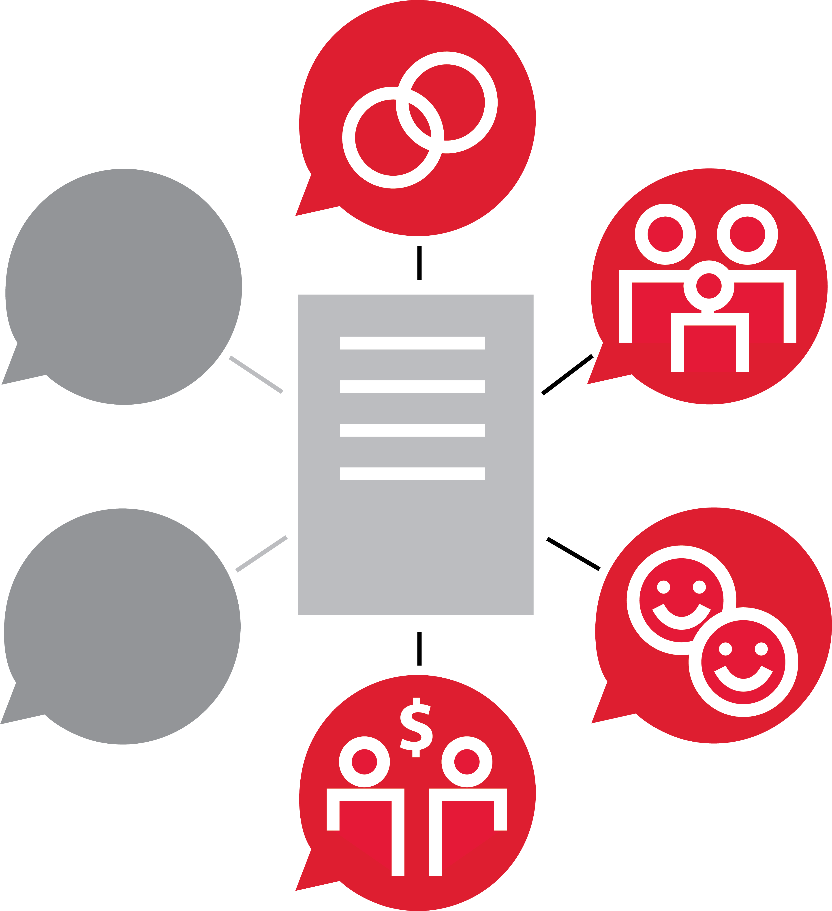
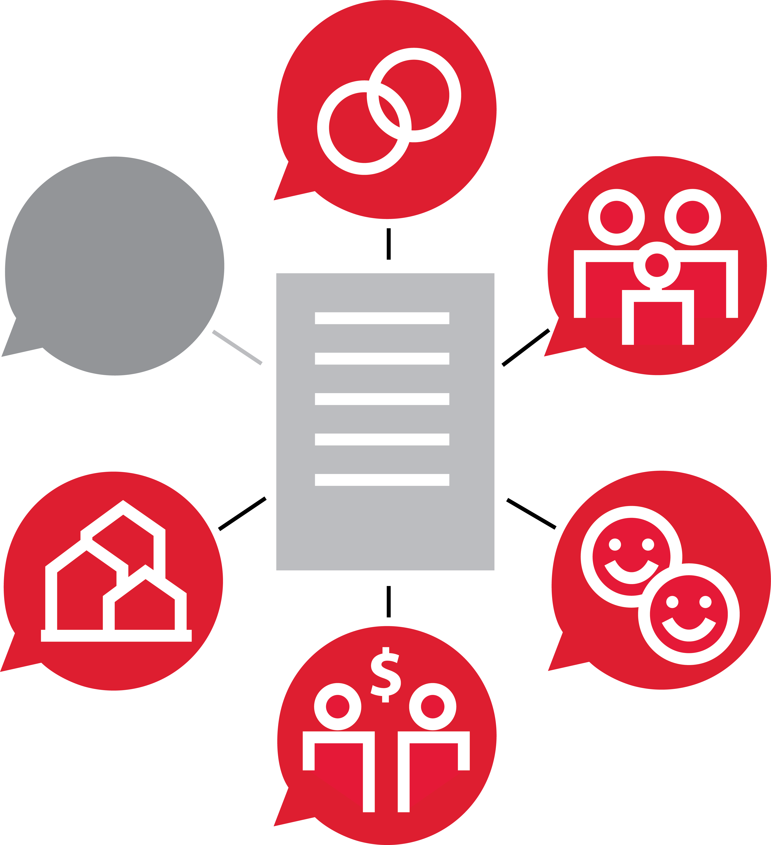

Personal Mission Statement™

Slide 15









Organizations of Character™

Slide 16



Input=Output™

Slide 17



Mentoring™

Slide 18


Feedback™

Slide 19
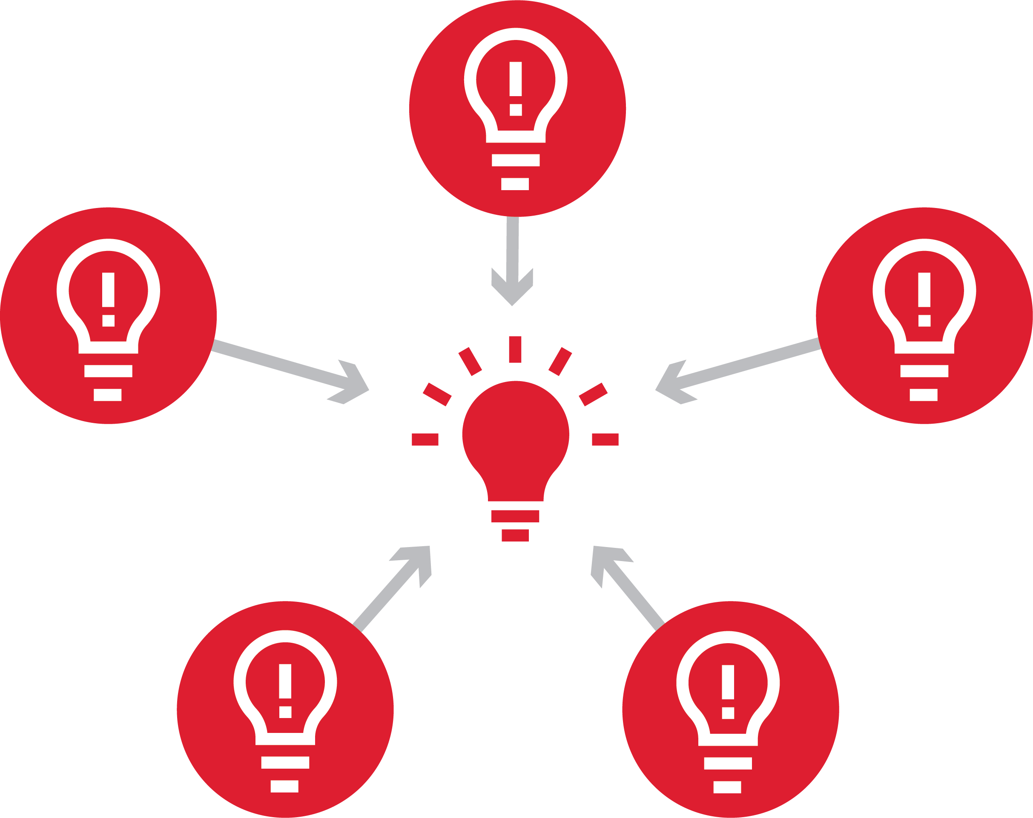

Mastermind Groups™

Slide 20


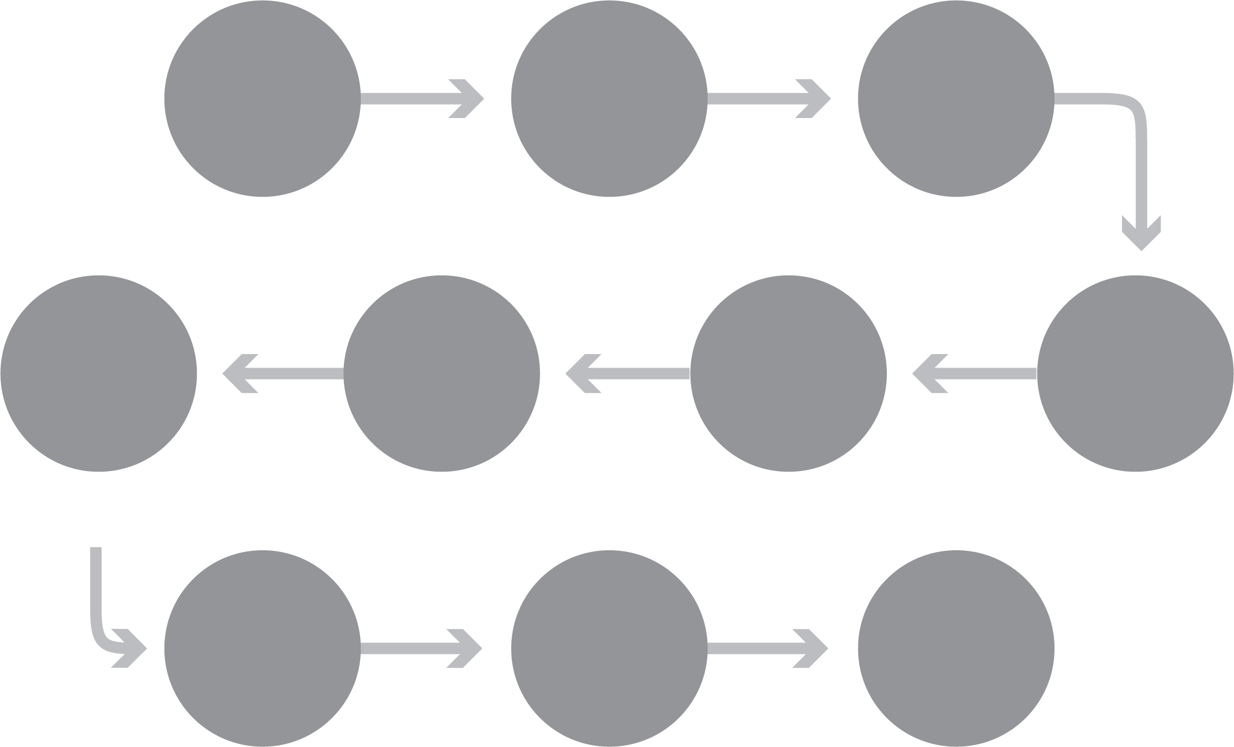








Cascading People Development Initiatives™

Slide 21

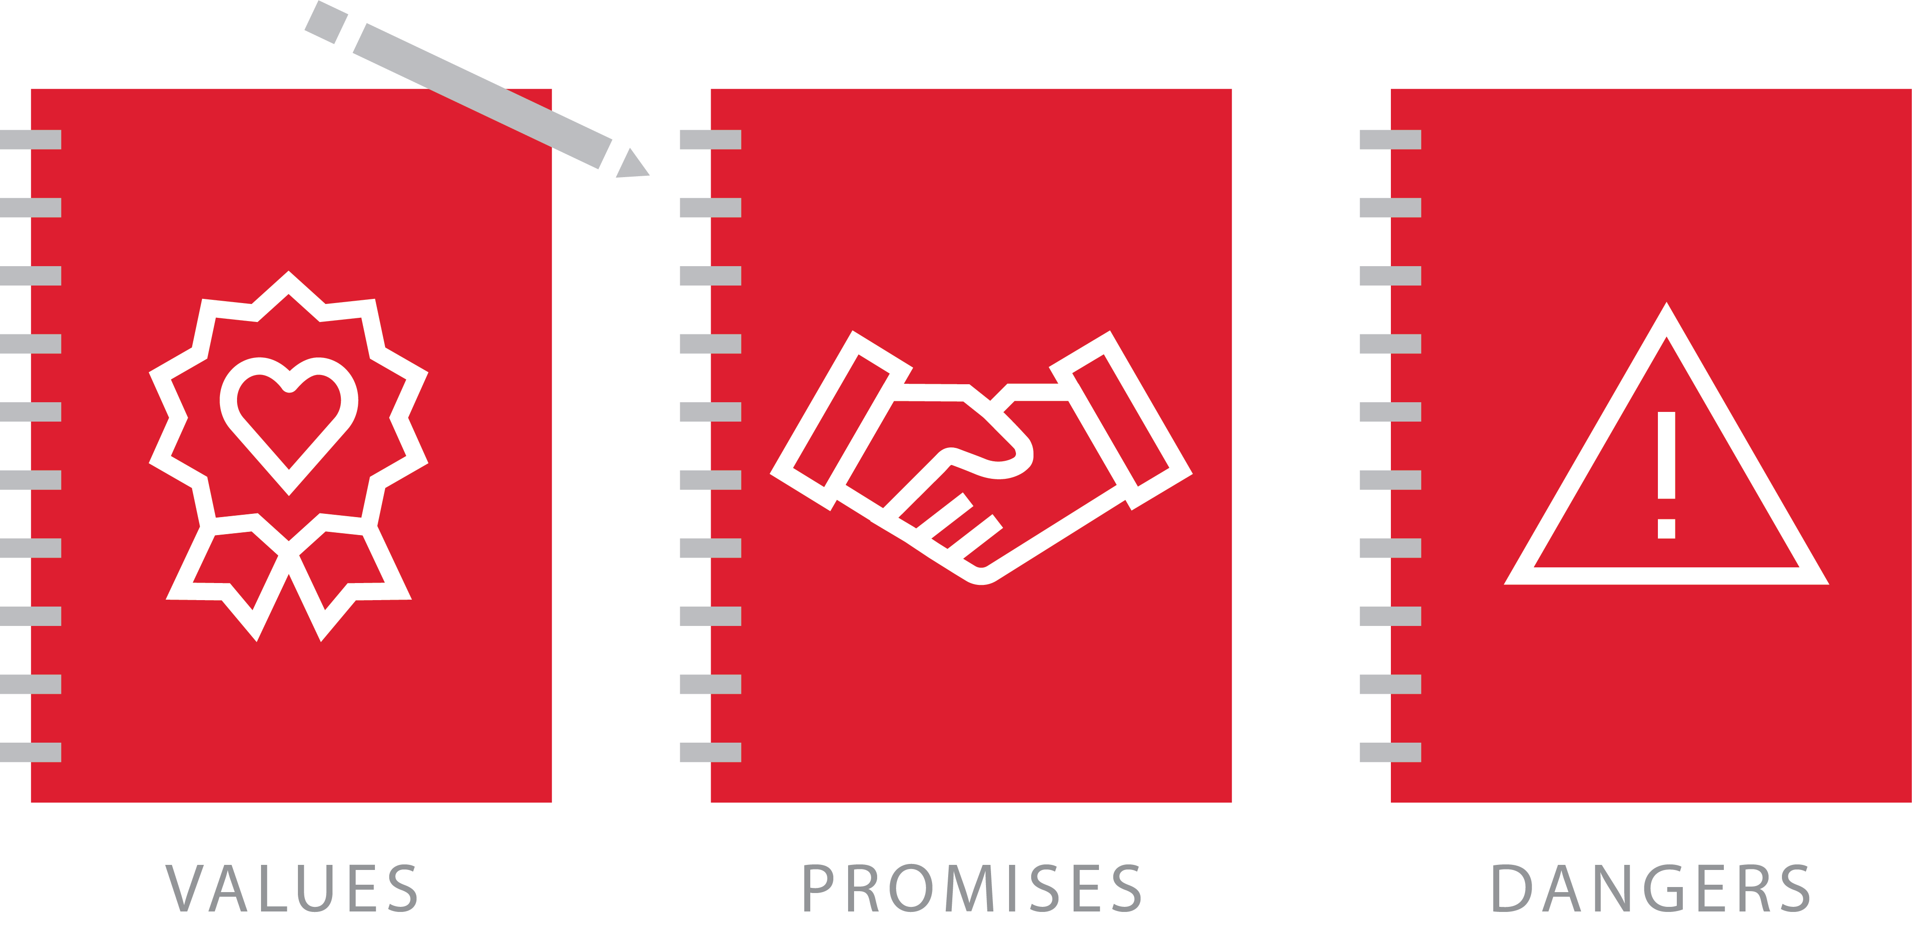
Personal Commitment Reflection™

Slide 22
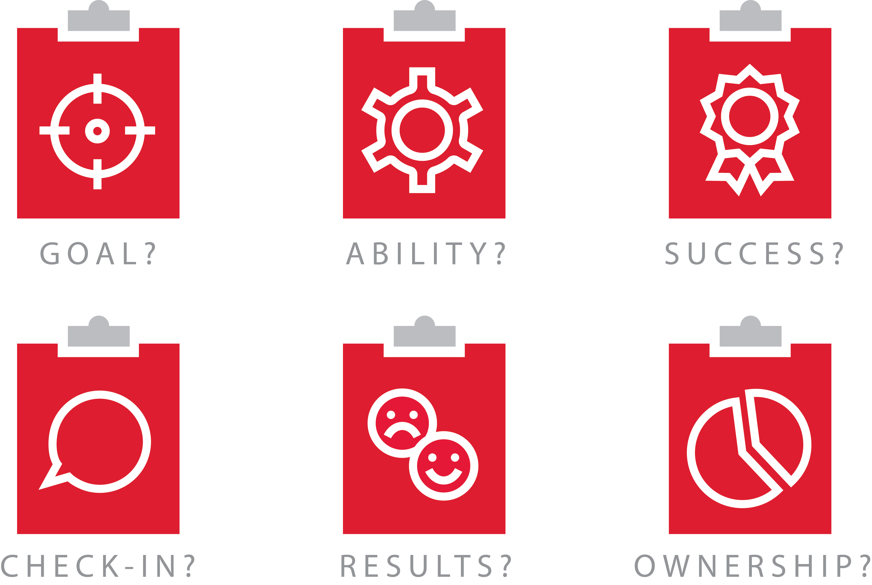

Six-Step Accountability Framework™

Slide 23


10 Steps to Rebuild Trust™

Slide 24
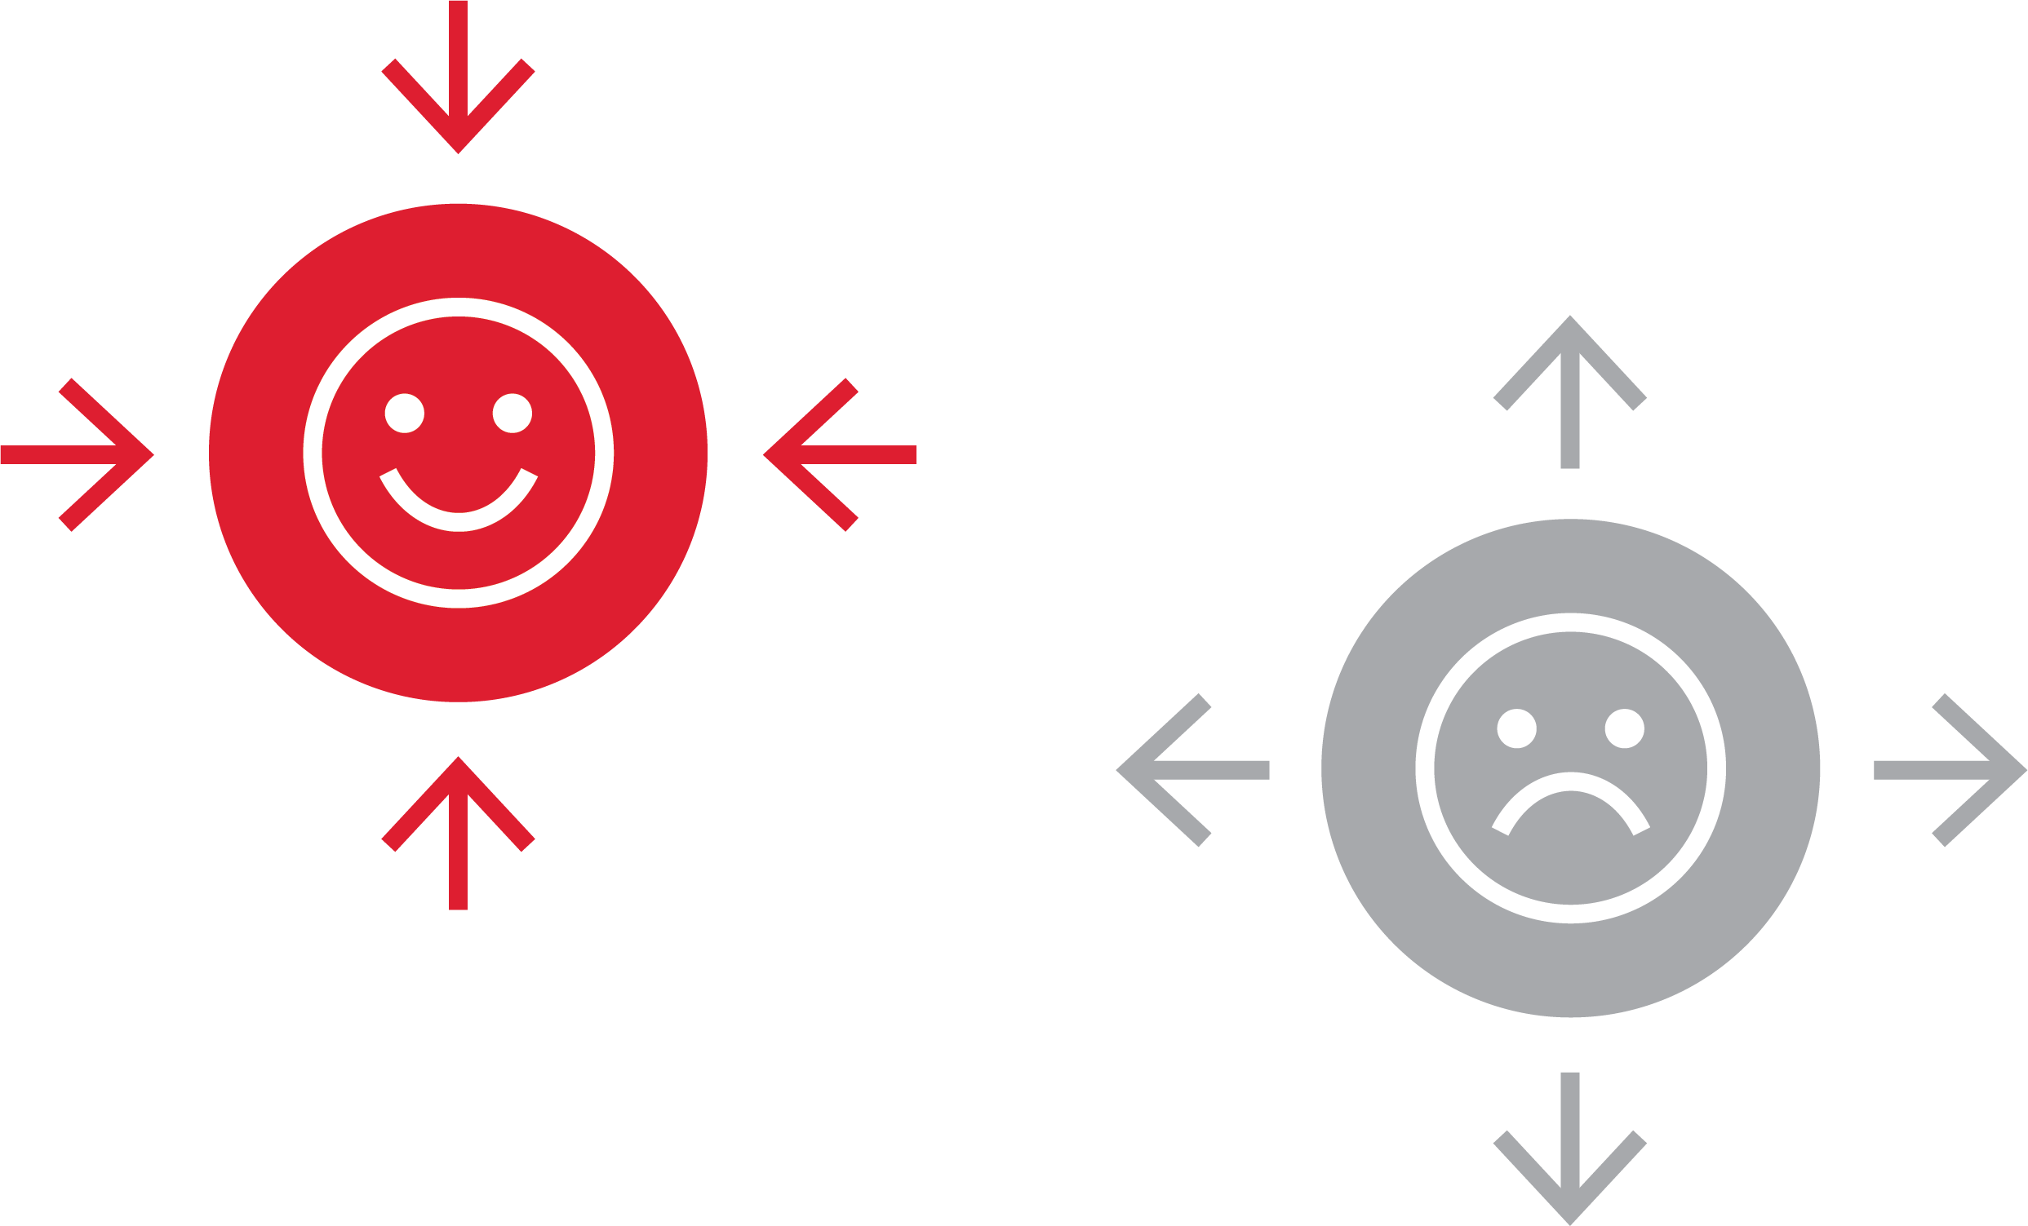
Magnetic Traits vs. Repelling Traits™

Slide 25




Curious Questions™

Slide 26



Storytelling™

Slide 27

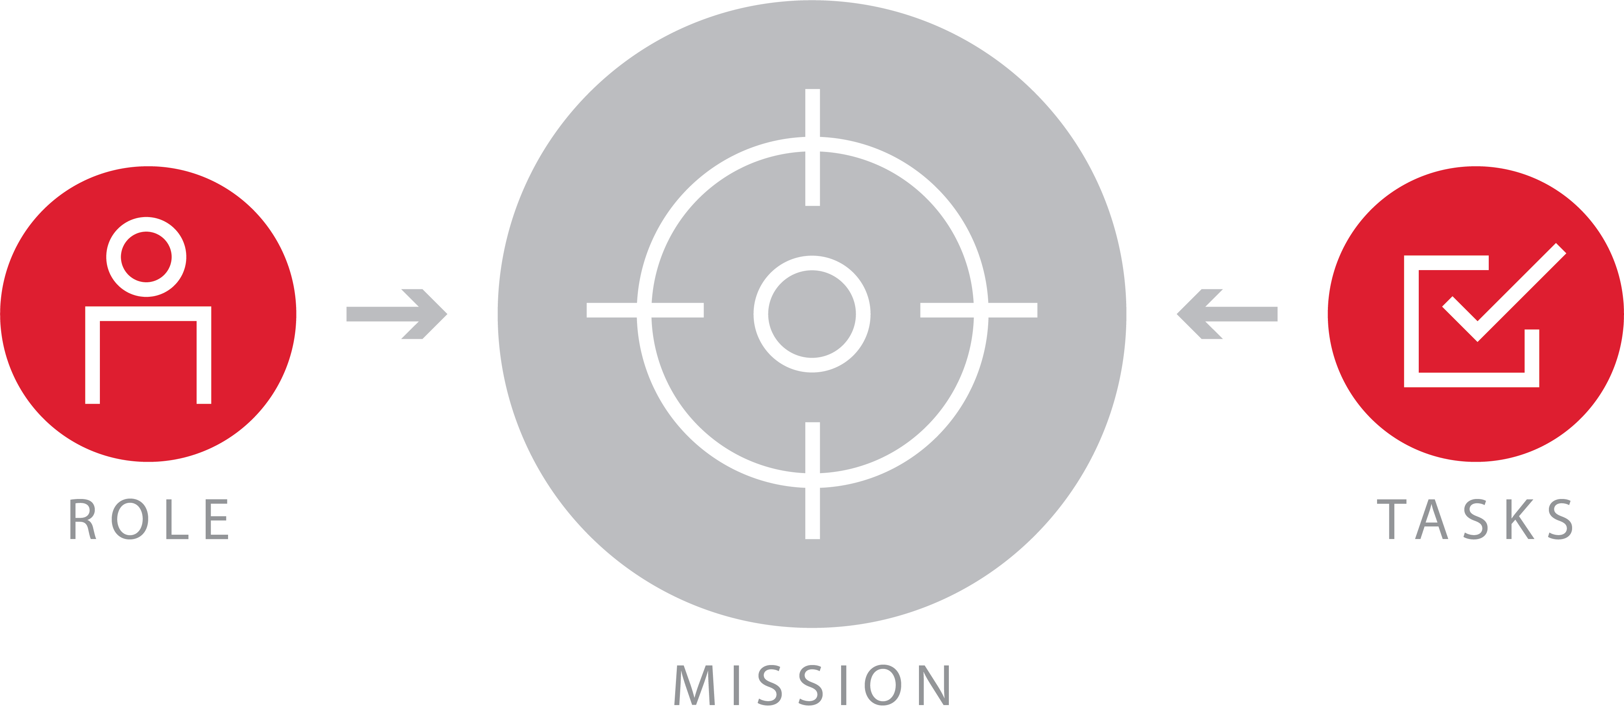
Engagement Statement™

Slide 28
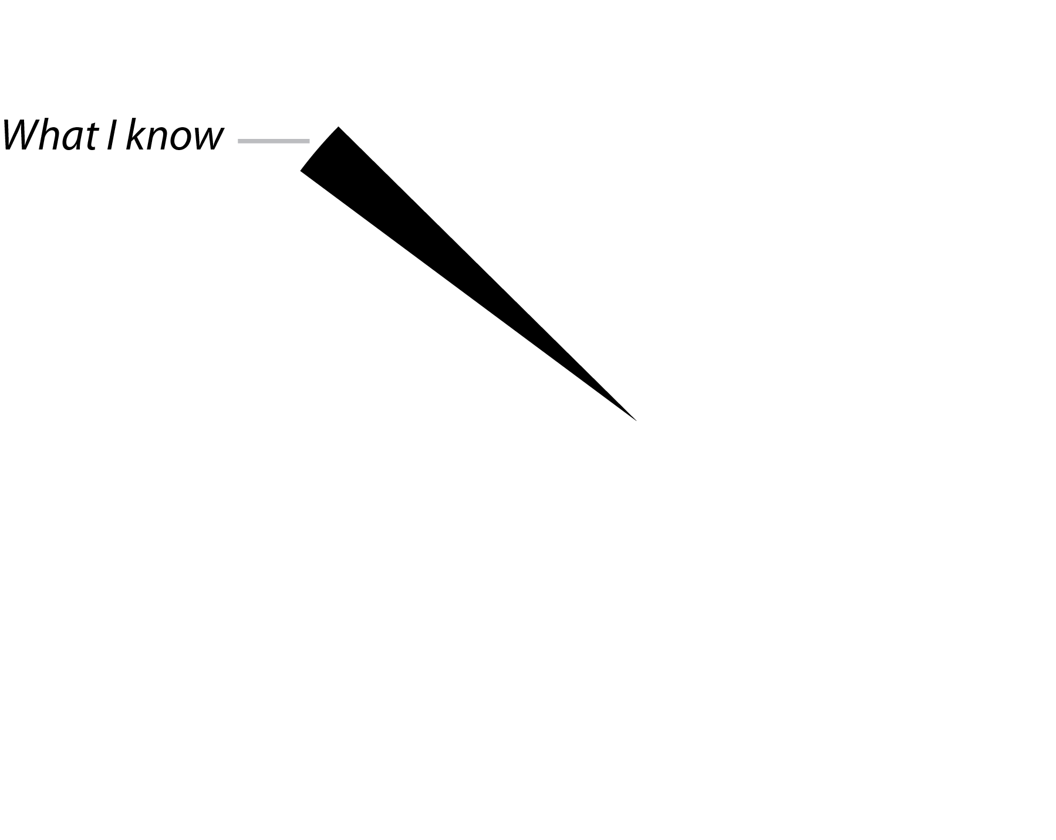



The Solving Circle™

Slide 29
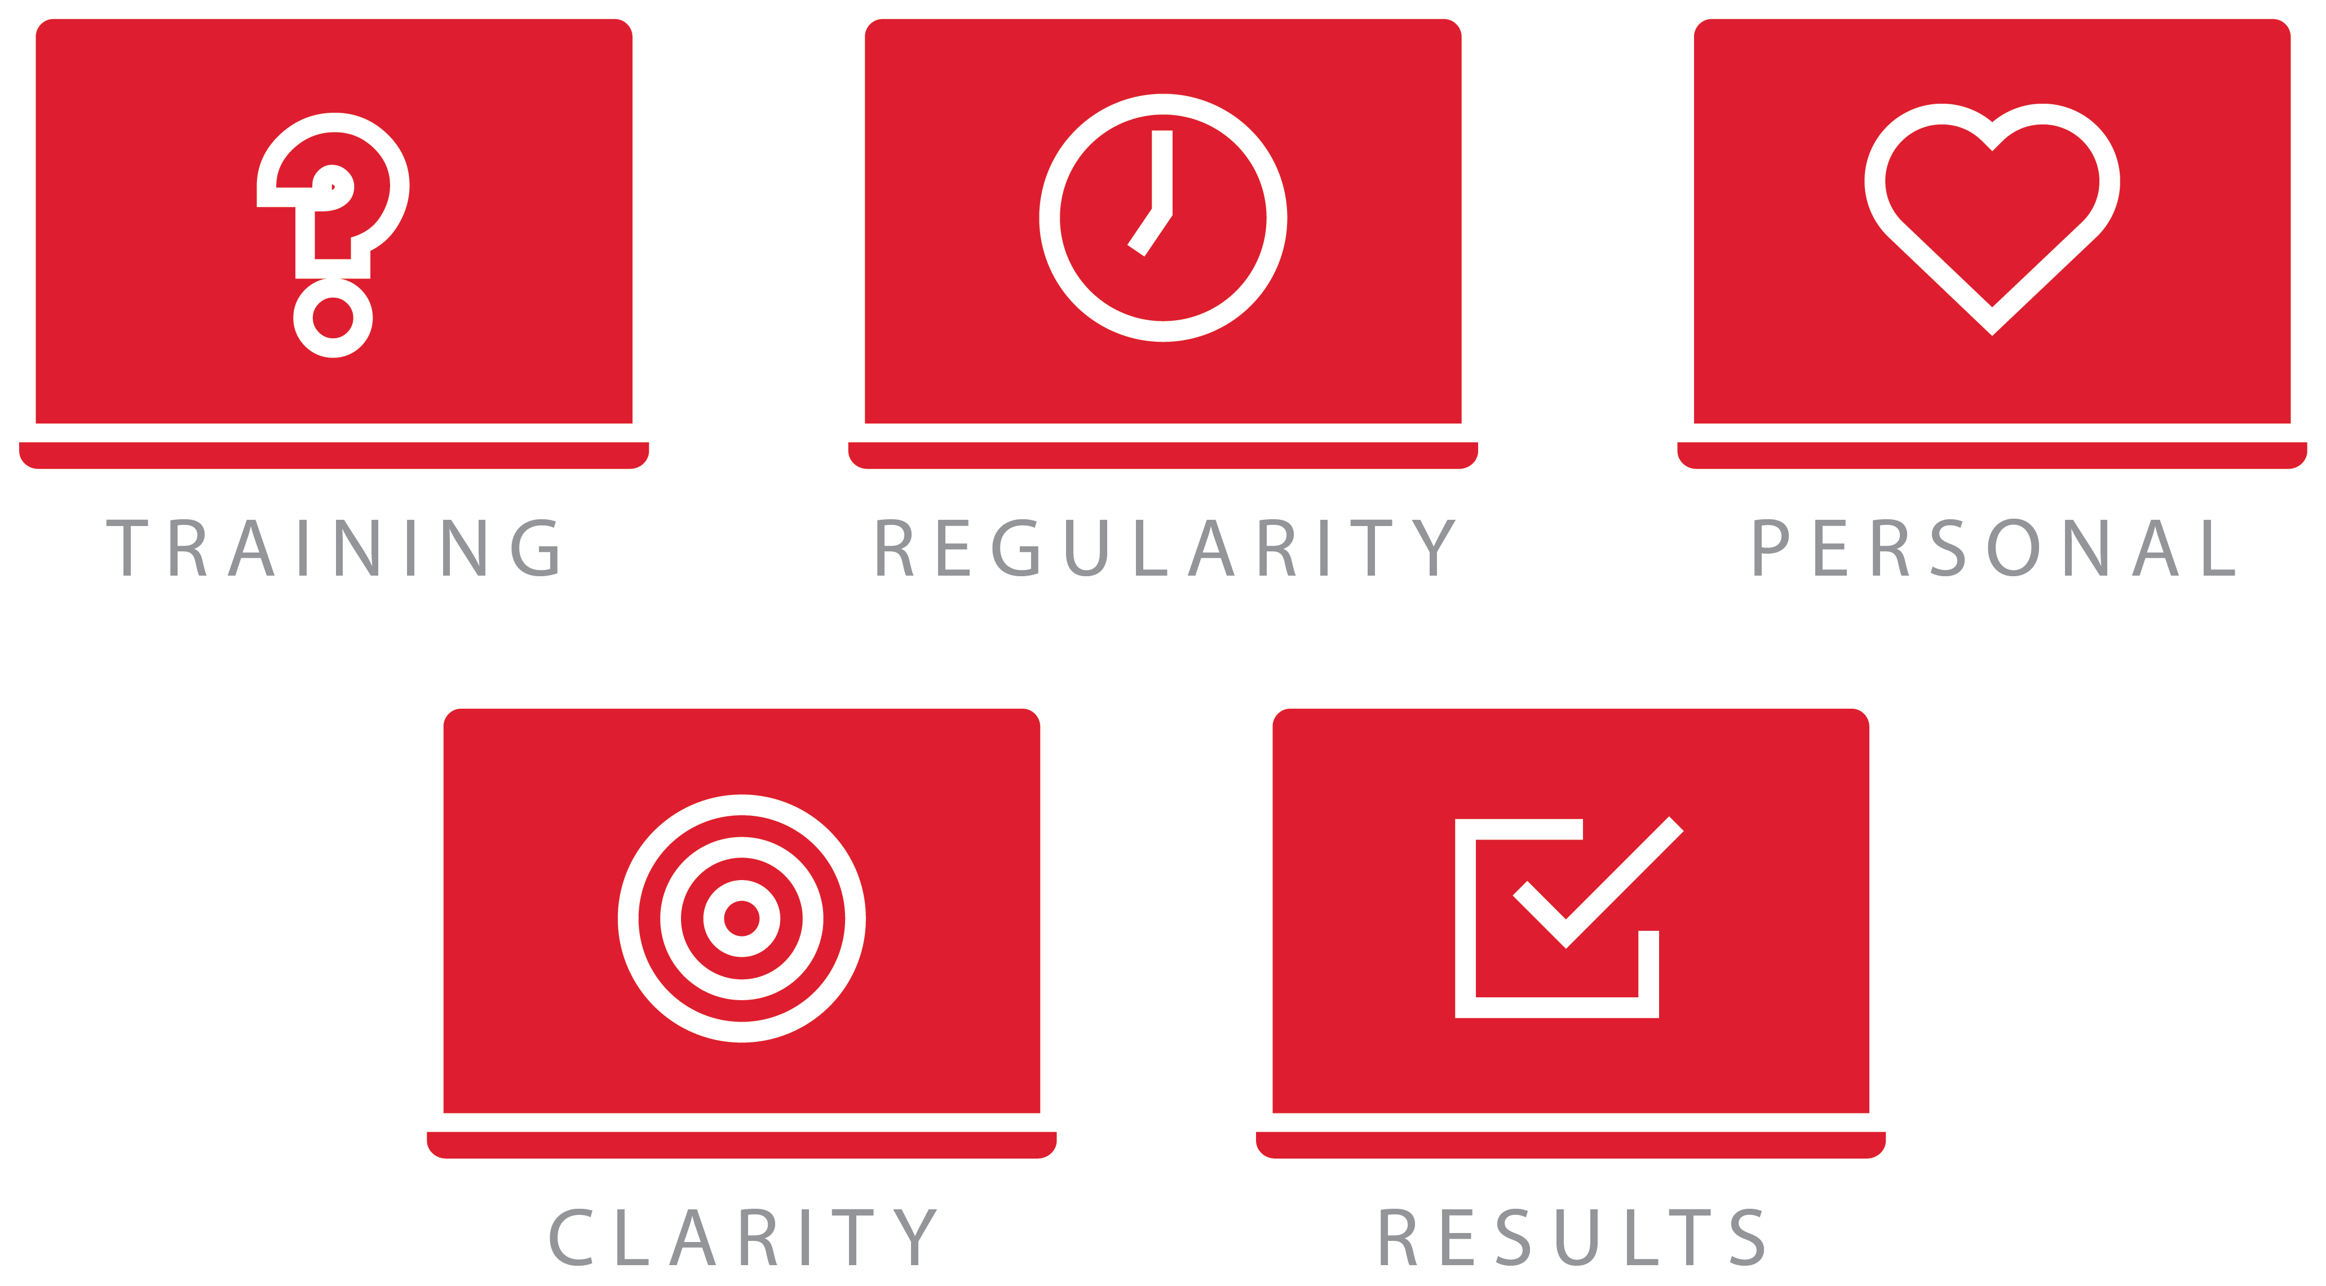

Five Ways to Build Virtual Trust™

Slide 30

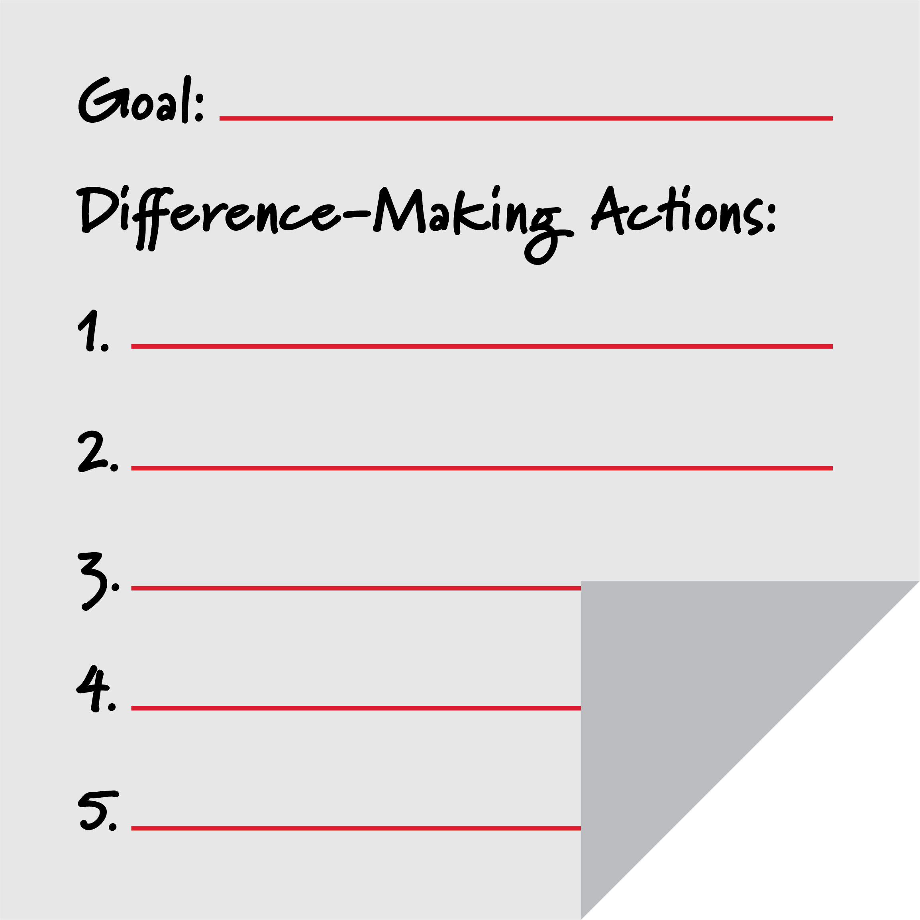

Difference-Making Actions™

Slide 31


Task Bundles™

Slide 32


Power Hour™

Slide 33


Six E’s of Motivation™

Slide 34

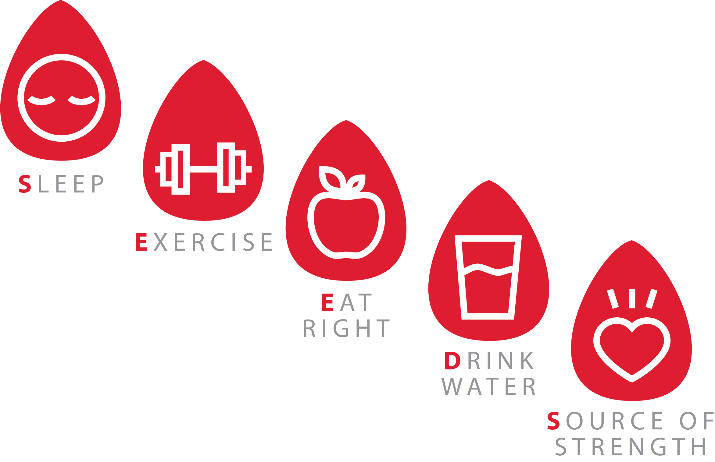
SEEDS™

Slide 35


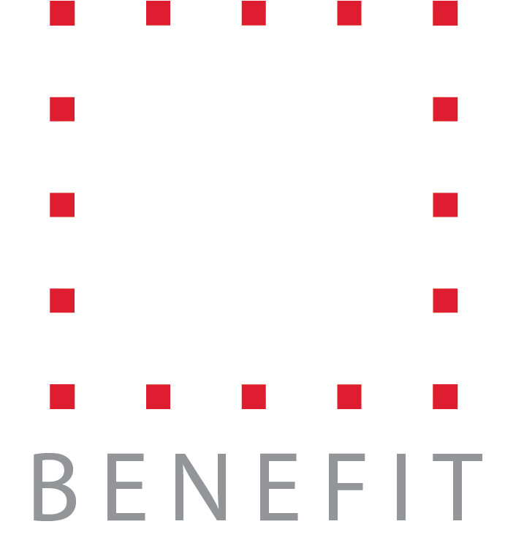
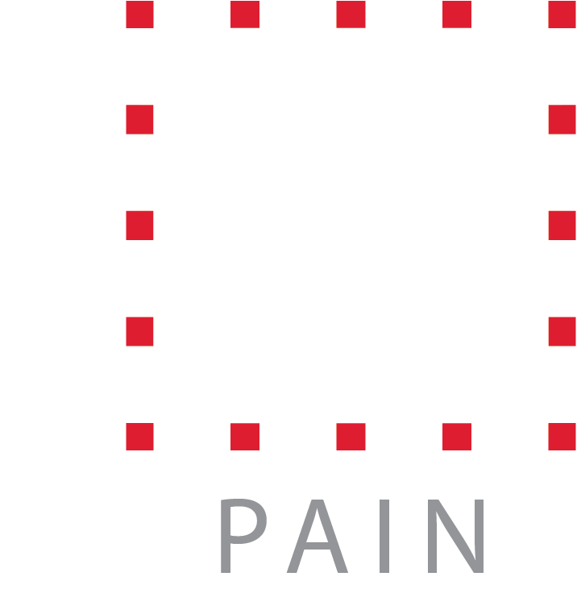
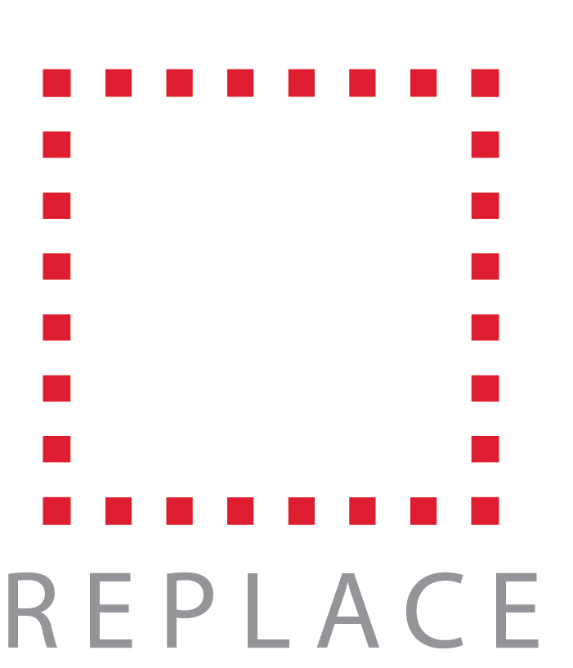
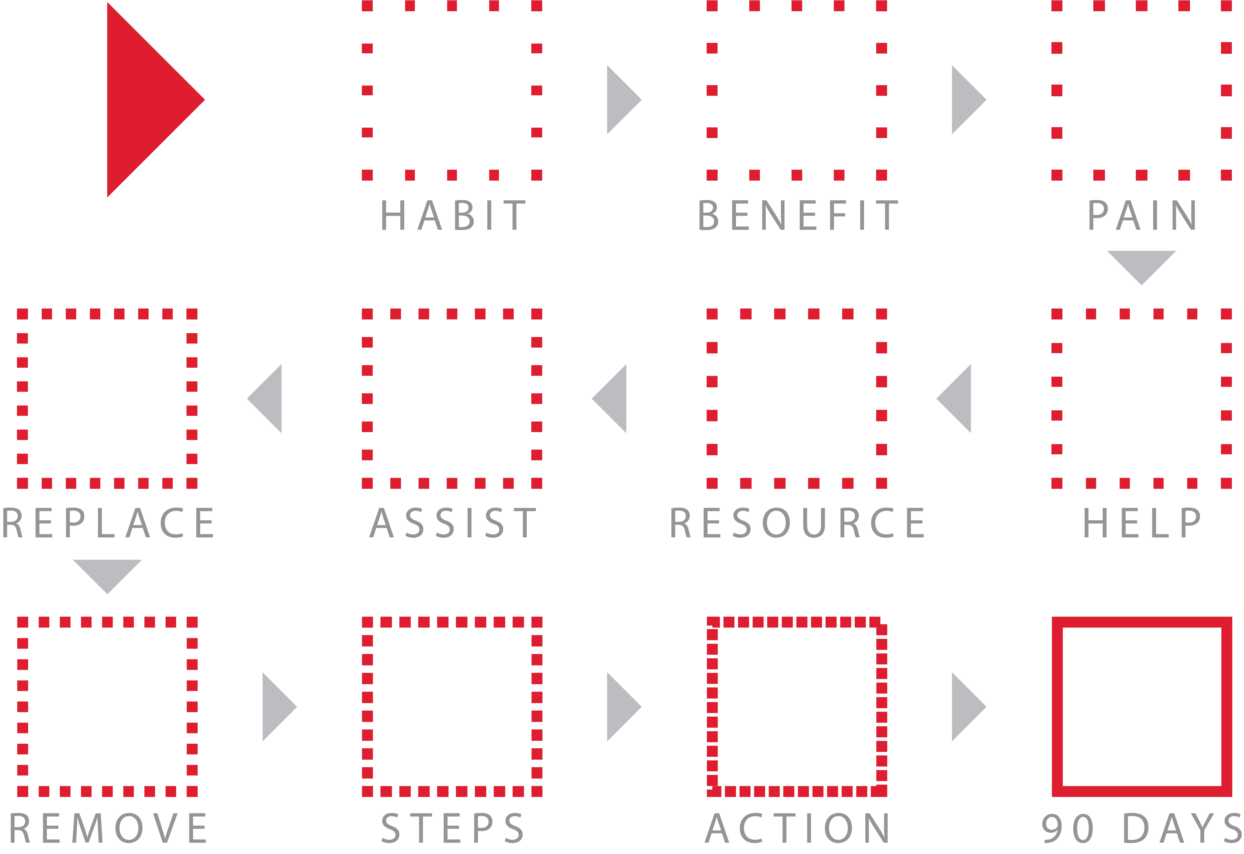
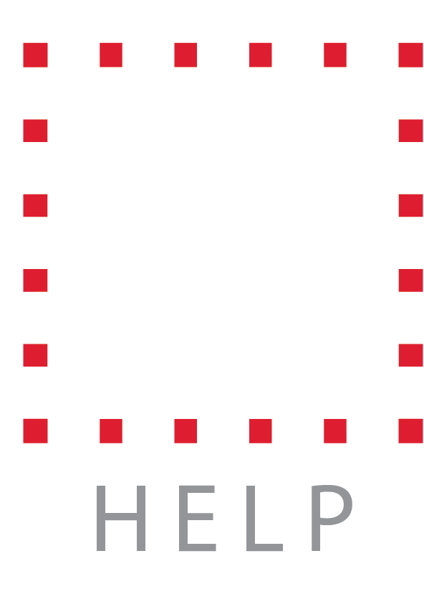
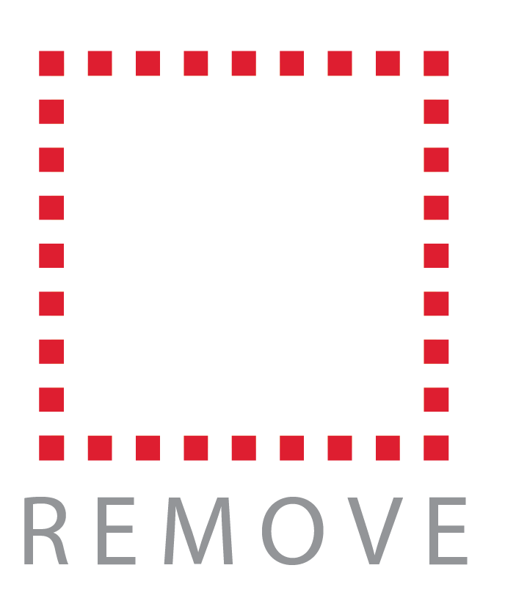
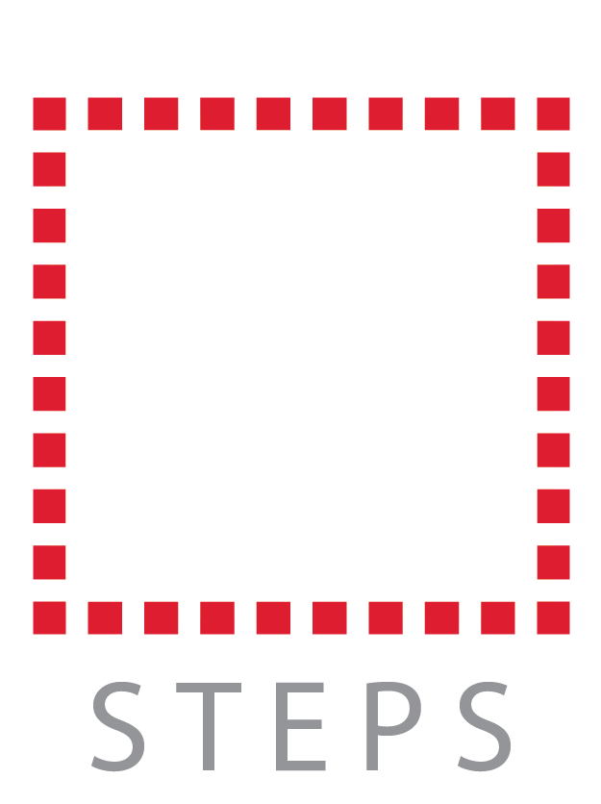
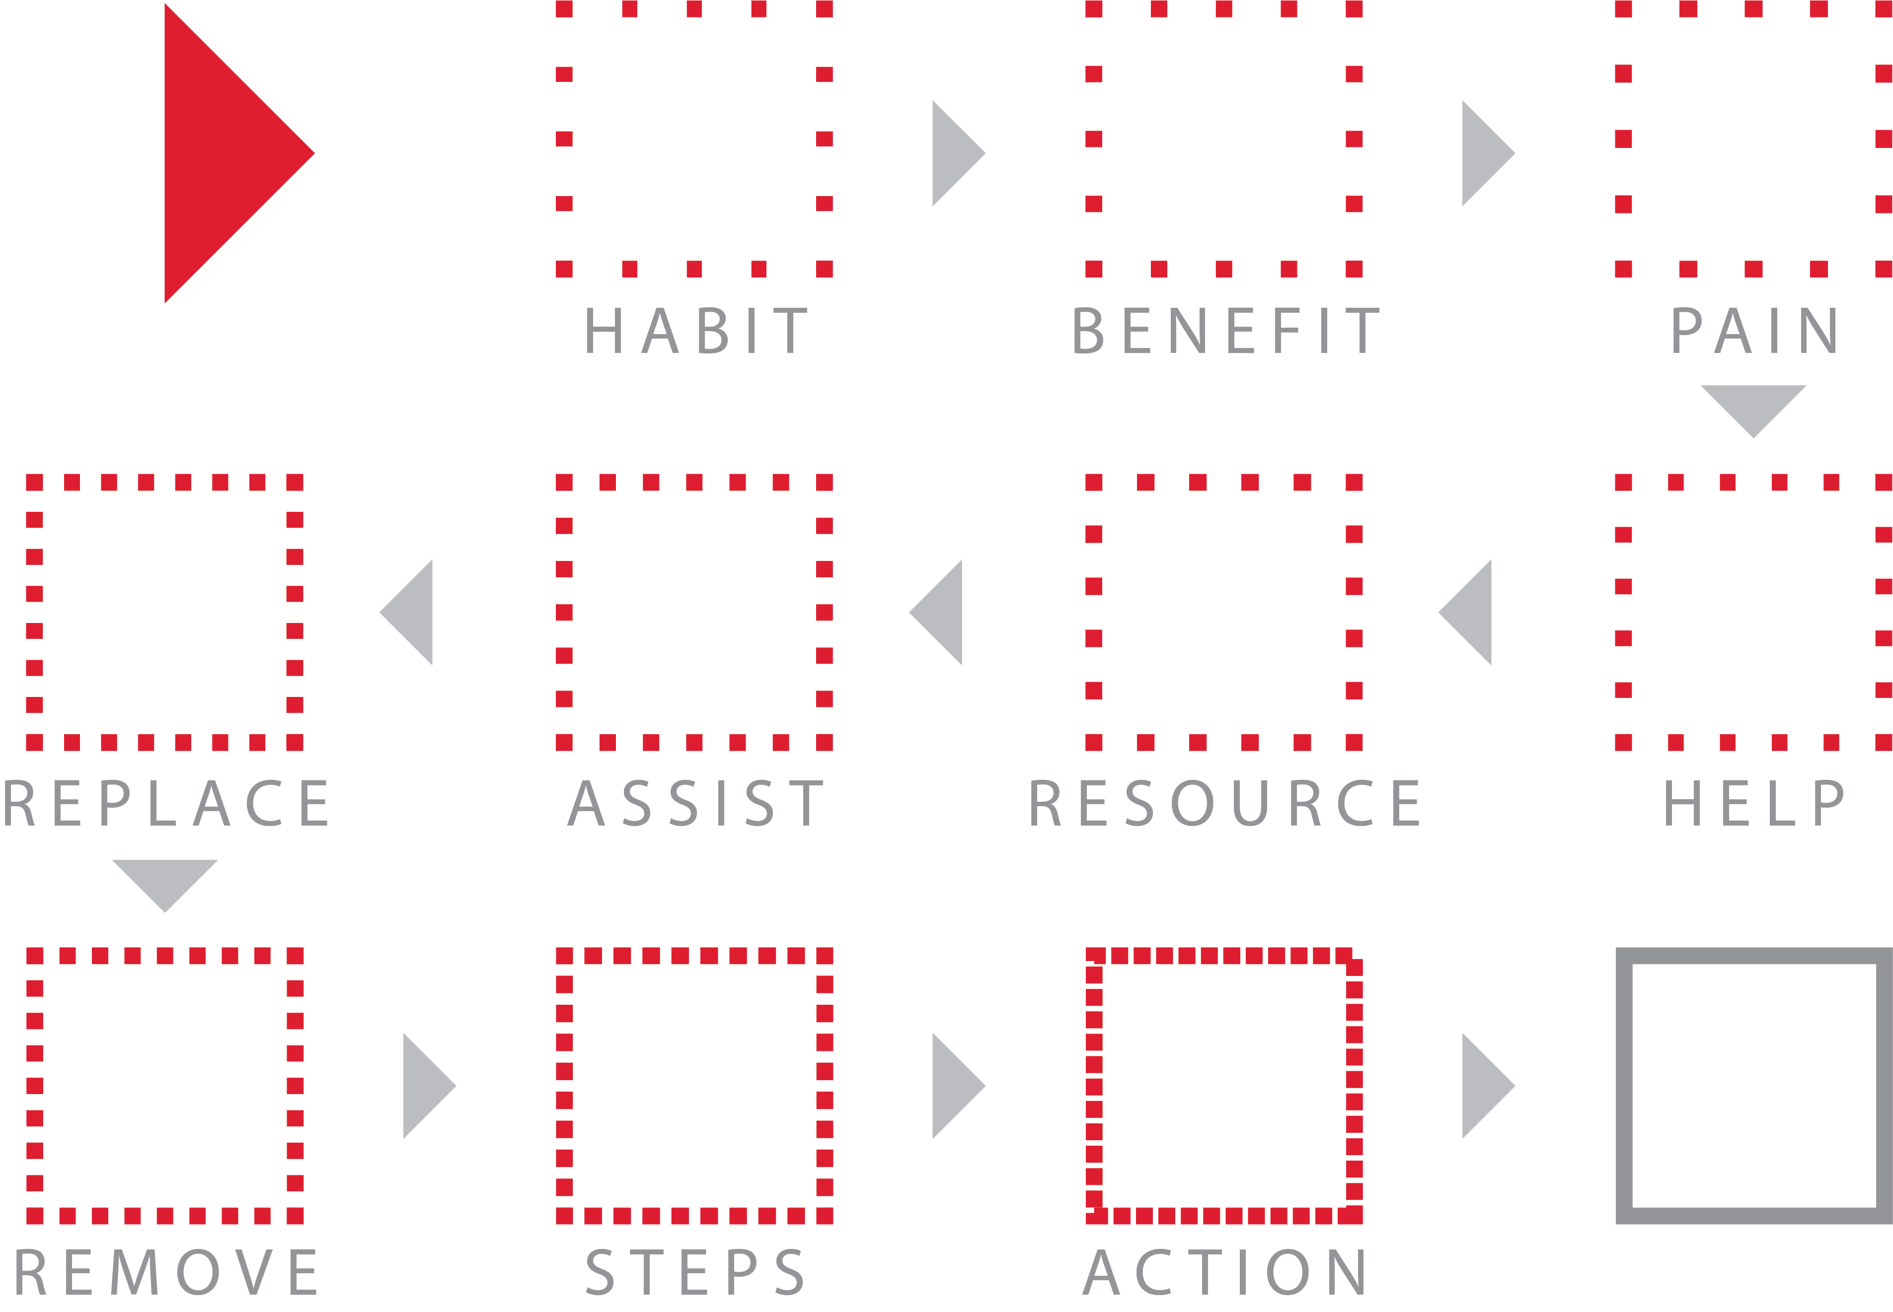
Habit Change™

Slide 36

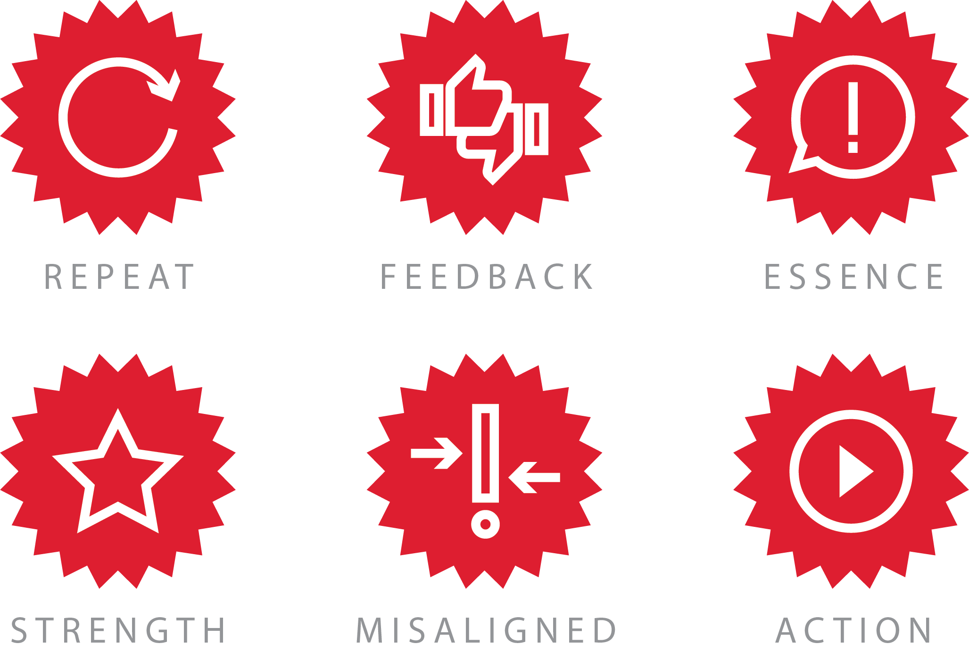
Brand Review™

Slide 37
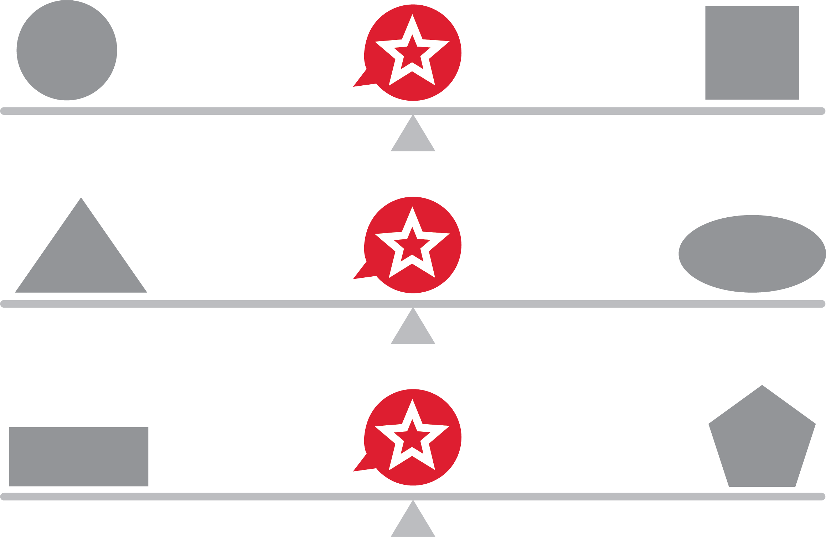
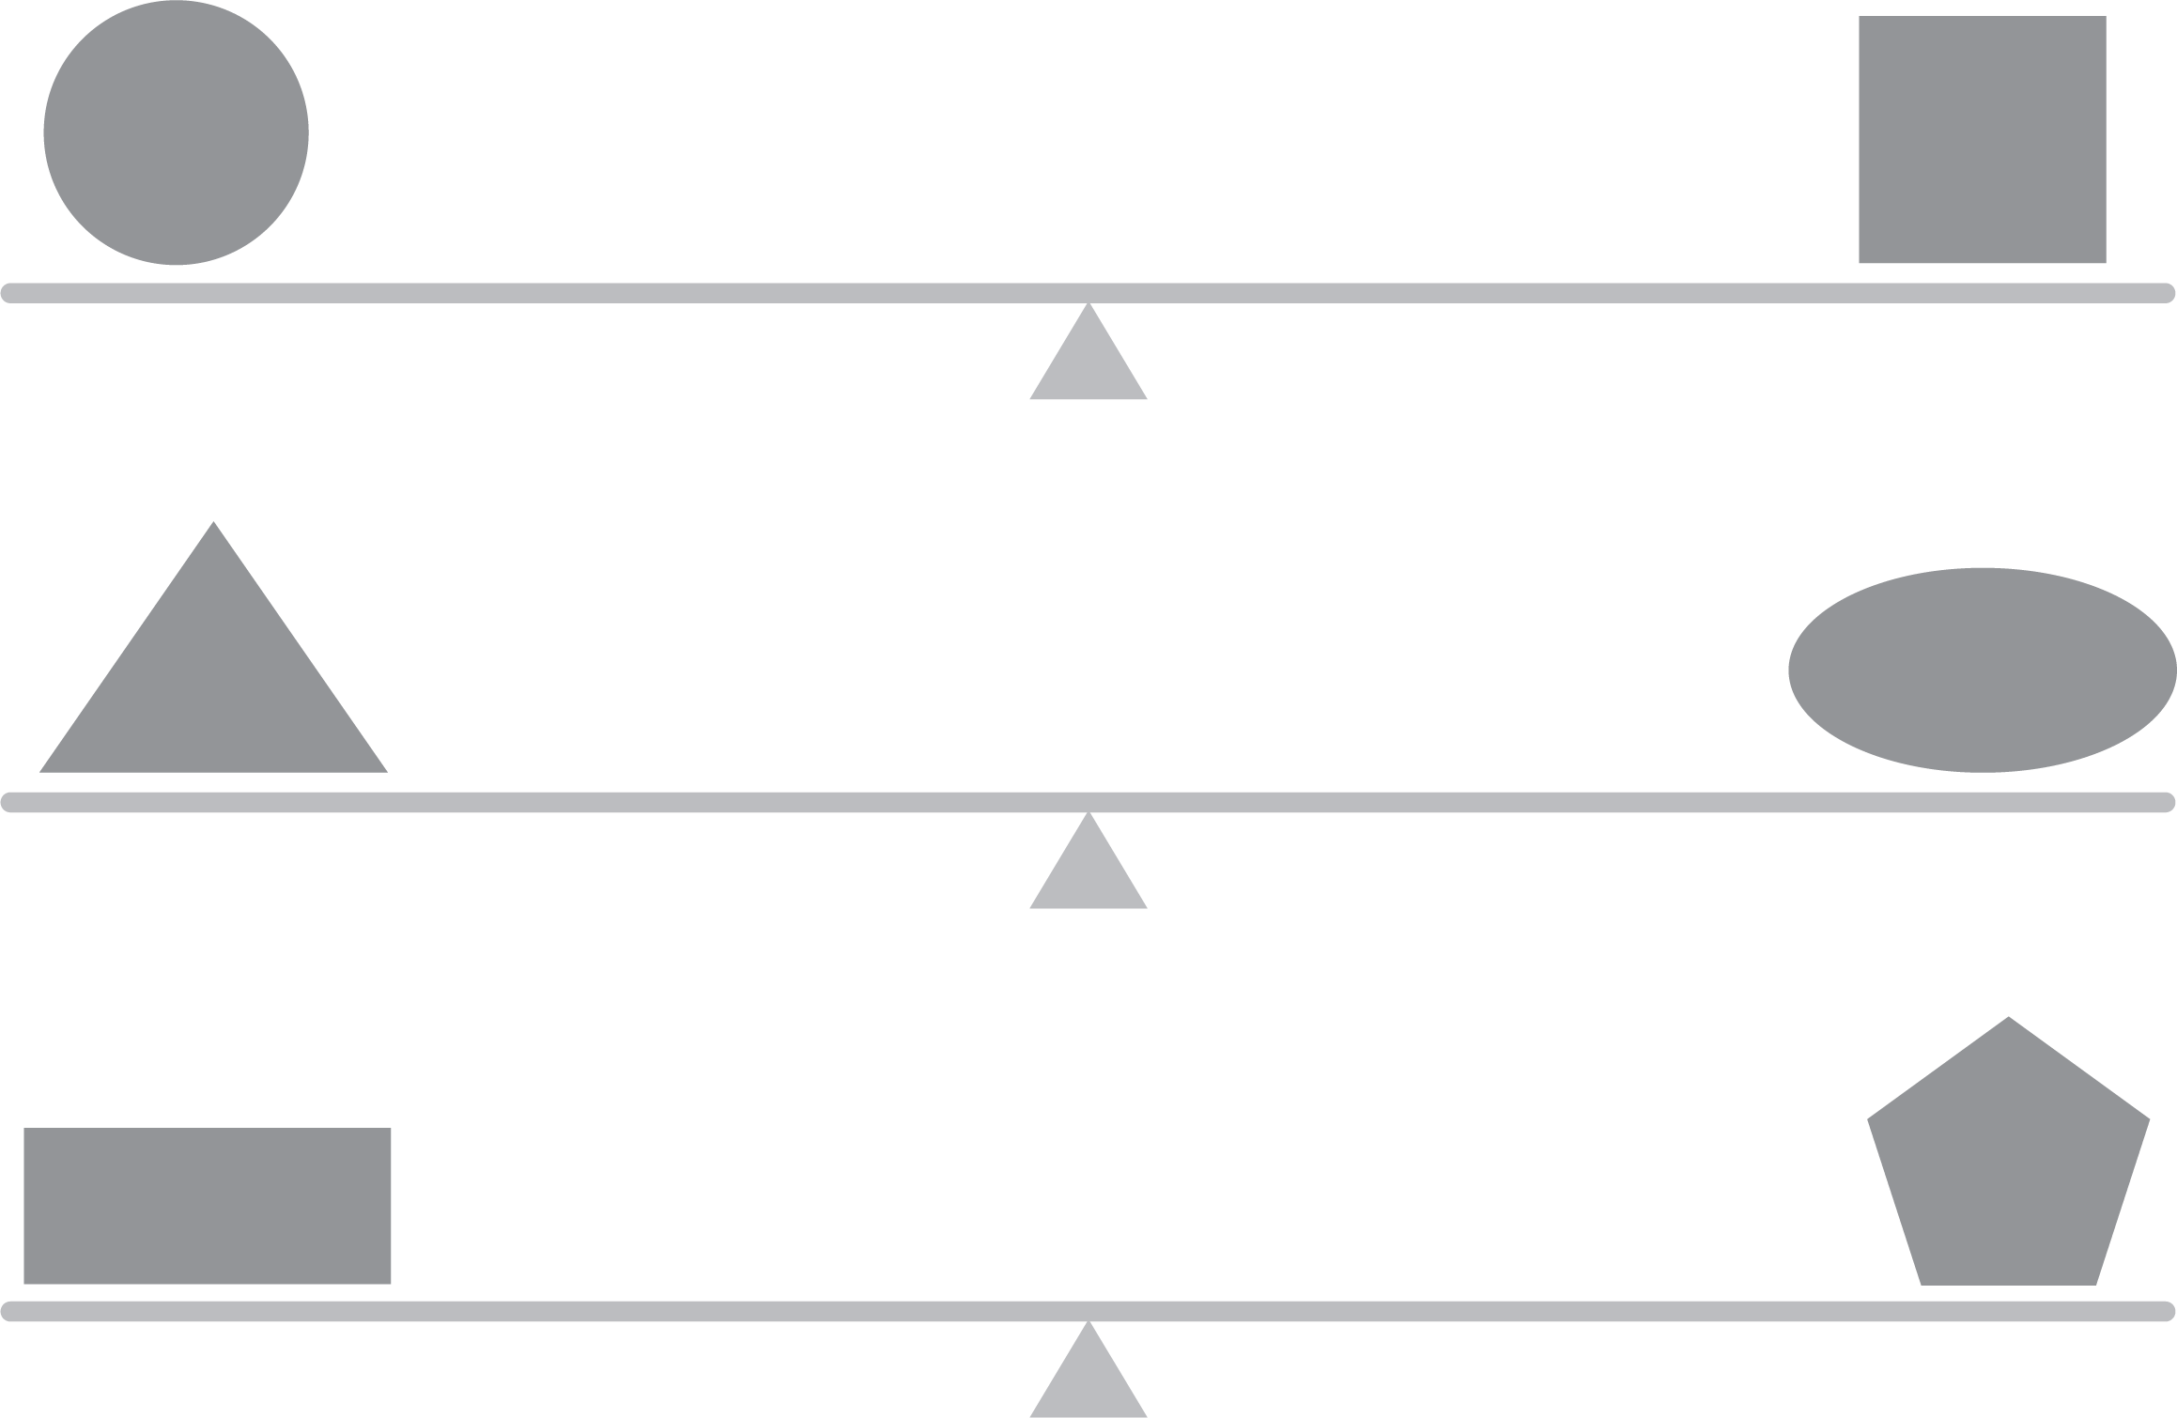
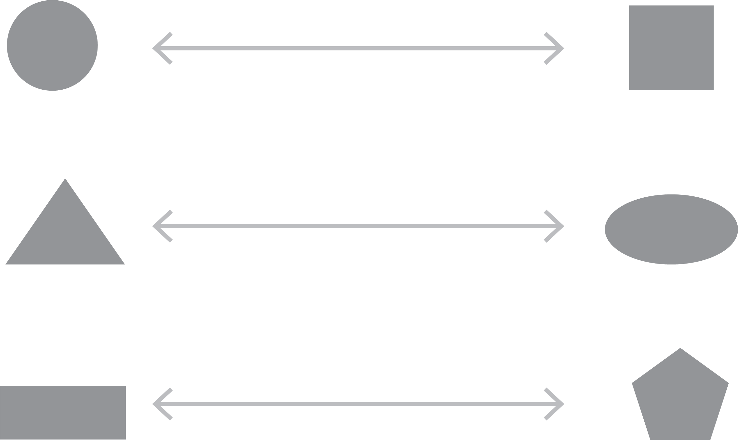
Brand Balance™

Slide 38






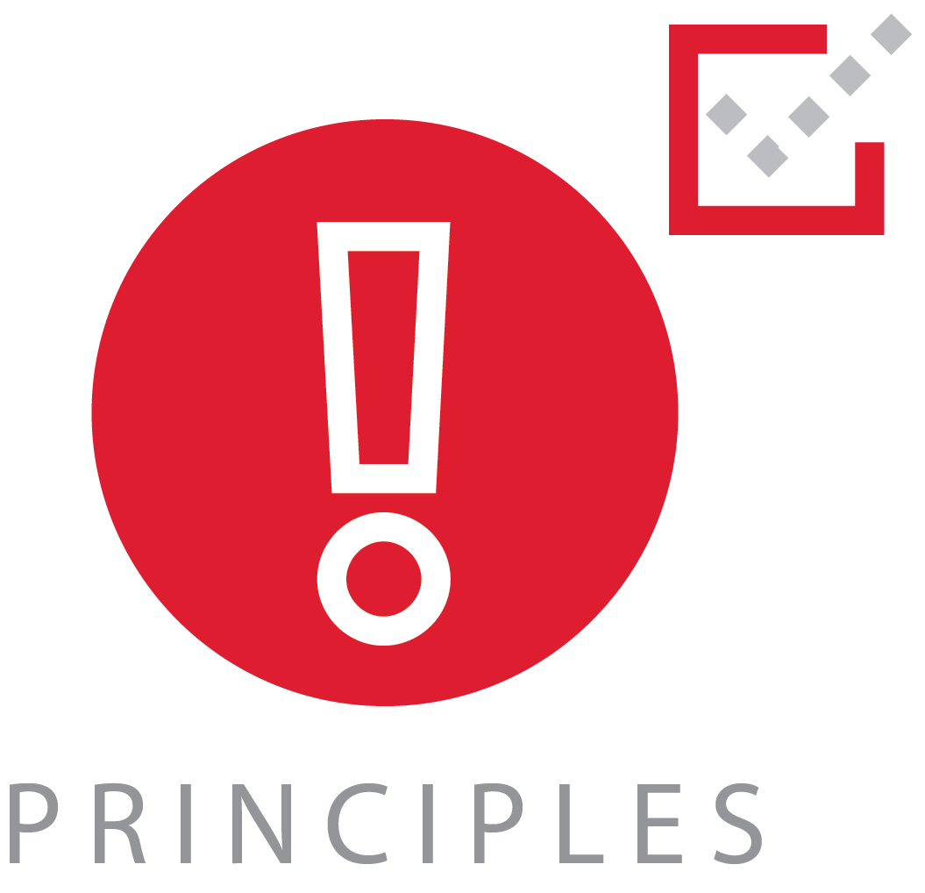


The Great Eight for Self-Trust™

Slide 39
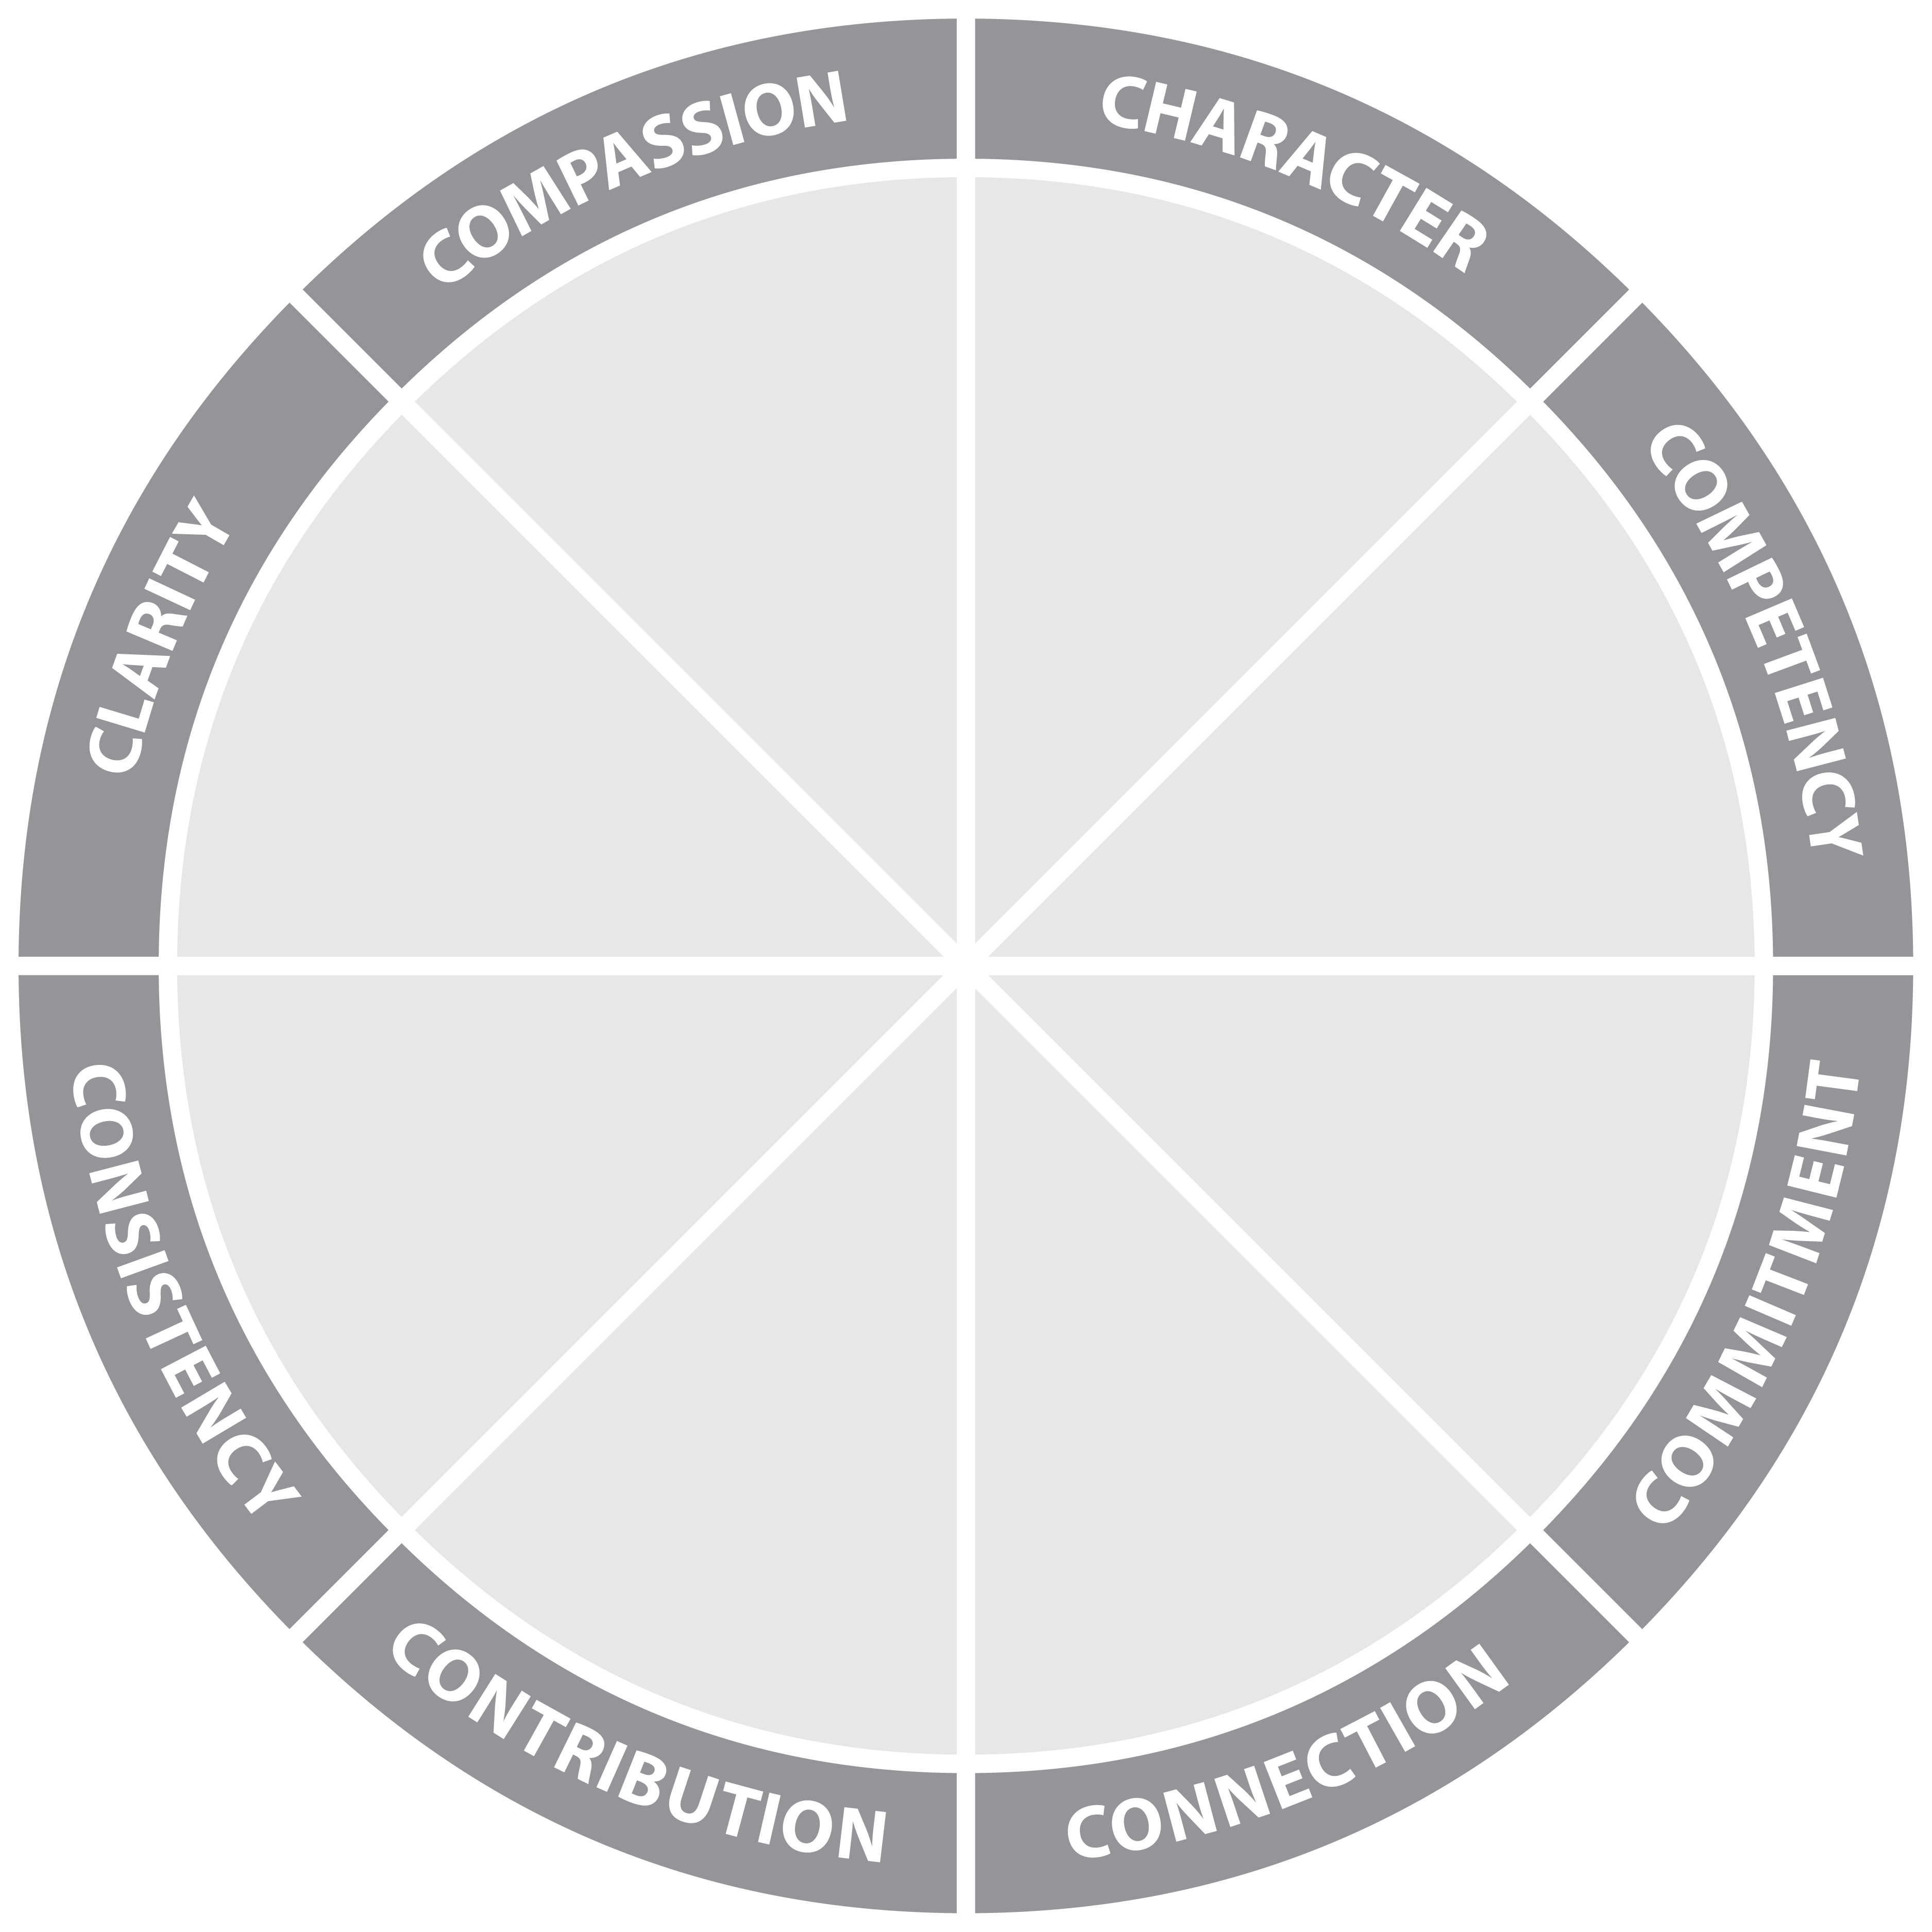
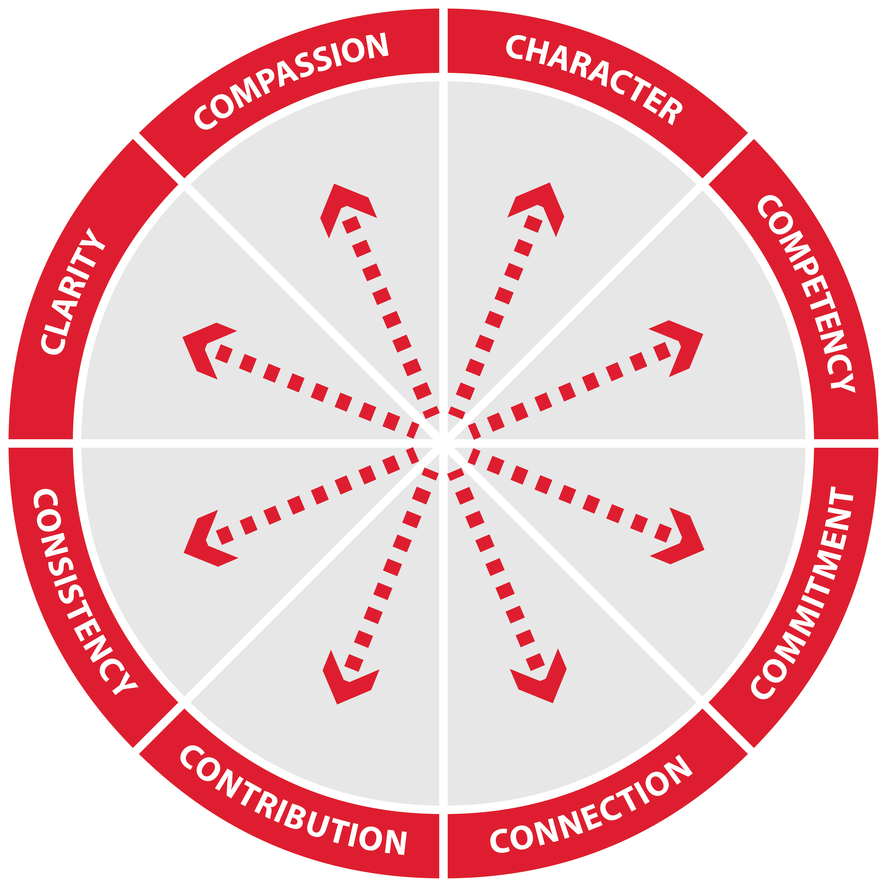
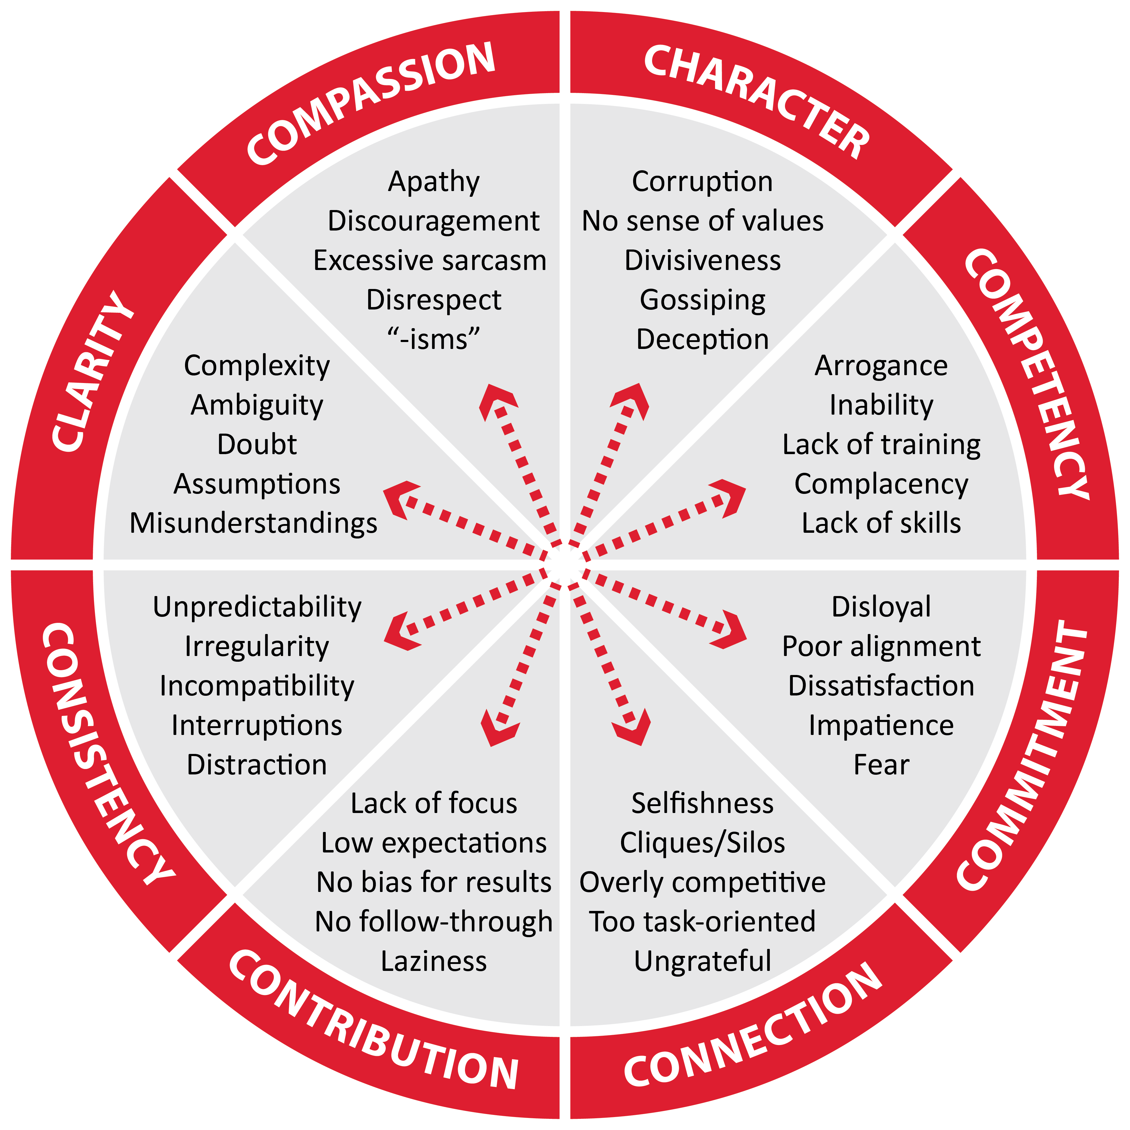
Counterforce Wheel™

Slide 40



Building Trust Through Crisis & Change™

